Slide 1

DB Apps Introduction
Intro to ADO.NET
SoftUni Team
Technical Trainers
Software University
http://softuni.bg

Slide 2
Table of Contents
Data Access Models
ADO.NET Architecture
Accessing SQL Server from ADO.NET
SQL Injection

Slide 3
Have a Question?
sli.do
#csharp-db

Slide 4

Data Access Models
Connecting to a DB through C#

Slide 5


Connected Model
Connected data access model
Applicable to an environment where the database is constantly available
ADO.NET
constantly open
connection
DB
DB
ADO.NET client
Database

Slide 6
Connected Model: Benefits and Drawbacks
Connected data access model (SqlClient)
Benefits:
Concurrency control is easier to maintain
Better chance to work with the most recent version of the data
Drawbacks:
Needs a constant reliable network
Problems when scalability is an issue

Slide 7
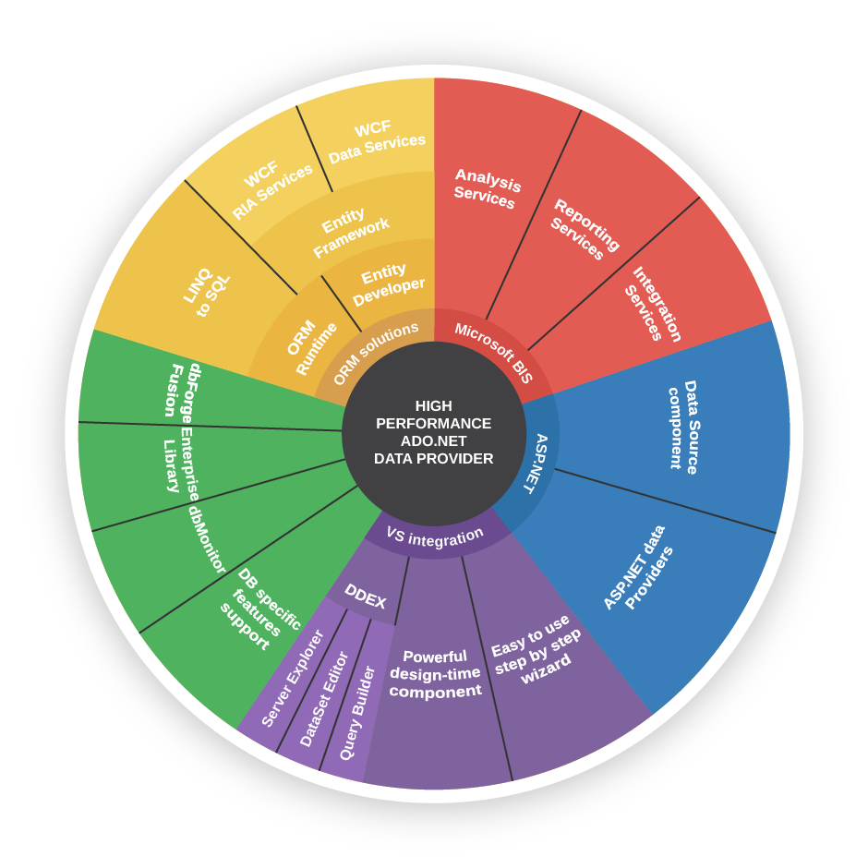
ADO.NET Architecture

Slide 8
What Is ADO.NET?
ADO.NET is a standard .NET class library for accessing databases, processing data and XML
Supports connected, disconnected and ORM data access models
Excellent integration with LINQ
Allows executing SQL in RDBMS systems
Allows accessing data in the ORM approach

Slide 9
Data Providers in ADO.NET
Data Providers are collections of classes that provide access to various databases
For different RDBMS systems different Data Providers are available
Several common objects are defined
Connection – to connect to the database
Command – to run an SQL command
DataReader – to retrieve data

Slide 10
Data Providers in ADO.NET (2)
Several standard ADO.NET Data Providers come as part of .NET Framework
SqlClient – accessing SQL Server
OleDB – accessing standard OLE DB data sources
Odbc – accessing standard ODBC data sources
Oracle – accessing Oracle databases
Third party Data Providers are available for:
MySQL, PostgreSQL, Interbase, DB2, SQLite
Other RDBMS systems and data sources
SQL Azure, Salesforce CRM, Amazon SimpleDB, …

Slide 11
SqlClient and ADO.NET Connected Model
Retrieving data in connected model
Open a connection (SqlConnection)
Execute command (SqlCommand)
Process the result set of the query by using a reader (SqlDataReader)
Close the reader
Close the connection
SqlDataReader
SqlParameter
SqlParameter
SqlCommand
SqlParameter
SqlConnection
Database

Slide 12
ORM Model
ORM data access model (Entity Framework Core)
Maps database tables to classes and objects
Objects can be automatically persisted in the database
Can operate in both connected and disconnected modes
OO
Programming
Language
ORM
Framework
Database

Slide 13
ORM Model – Benefits and Problems
ORM model benefits
Less code
Use objects with associations instead of tables and SQL
Integrated object query mechanism
ORM model drawbacks:
Less flexibility
SQL is automatically generated
Performance issues (sometimes)

Slide 14
ADO.NET: Entity Framework Core
Entity Framework Core is a generic ORM framework
Create entity data model mapping the database
Open an object context
Retrieve data with LINQ / modify the tables in the object context
Persist the object context changes into the DB
Connection is automatically managed

Slide 15

SQL Client Data Provider

Slide 16
SqlClient Data Provider
SqlConnection
Establish database connection to SQL Server
SqlCommand
Executes SQL commands on the SQL Server through an established connection
Could accept parameters (SQLParameter)
SqlDataReader
Retrieves data (record set) from SQL Server as a result of SQL query execution

Slide 17
The SqlConnection Class
SqlConnection establishes a connection to SQL Server database
Requires a valid connection string
Connection string example:
Connecting to SQL Server:
Data Source=(local)\SQLEXPRESS;Initial Catalog=SoftUni;Integrated Security=true;
SqlConnection con = new SqlConnection(
@"Server=.;
Database=SoftUni;
Integrated Security=true");
con.Open();

Slide 18
SqlConnection – Example
Creating and opening connection to SQL Server (database SoftUni)
SqlConnection dbCon = new SqlConnection(
"Server=.\\SQLEXPRESS; " +
"Database=SoftUni; " +
"Integrated Security=true");
dbCon.Open();
using (dbCon)
{
//TODO: Use the connection to execute SQL commands here …
}

Slide 19
DB Connection String
Database connection string
Defines the parameters needed to establish the connection to the database
Settings for SQL Server connections:
Data Source / Server – server name / IP address + database instance name
Database / Initial Catalog – database name
User ID / Password – credentials
Integrated Security – false if credentials are provided

Slide 20

Working with SqlConnection
Explicitly opening and closing a connection
Open() and Close() methods
Works through the connection pool
DB connections are IDisposable objects
Always use the using construct in C#!

Slide 21
The SqlCommand Class
More important methods
ExecuteScalar()
Returns a single value - the value in the first column of the first row of the result set (as System.Object)
ExecuteReader()
Returns a SqlDataReader
It is a cursor over the returned records (result set)
CommandBehavior – assigns some options
ExecuteNonQuery()
Used for non-query SQL commands, e.g. INSERT
Returns the number of affected rows (int)

Slide 22
SqlCommand – Example
SqlConnection dbCon = new SqlConnection(
"Server=.; " +
"Database=SoftUni; " +
"Integrated Security=true");
dbCon.Open();
using(dbCon)
{
SqlCommand command = new SqlCommand(
"SELECT COUNT(*) FROM Employees", dbCon);
int employeesCount = (int) command.ExecuteScalar();
Console.WriteLine("Employees count: {0} ", employeesCount);
}

Slide 23
The SqlDataReader Class
SqlDataReader retrieves a sequence of records (cursor) returned as result of an SQL command
Data is available for reading only (can't be changed)
Forward-only row processing (no move back)
Important properties and methods:
Read() – moves the cursor forward and returns false if there is no next record
Indexer[] – retrieves the value in the current record by given column name or index
Close() – closes the cursor and releases resources

Slide 24
SqlDataReader – Example
SqlConnection dbCon = new SqlConnection(…);
dbCon.Open();
using(dbCon)
{
SqlCommand command = new SqlCommand("SELECT * FROM Employees", dbCon);
SqlDataReader reader = command.ExecuteReader();
using (reader)
{
while (reader.Read())
{
string firstName = (string)reader["FirstName"];
string lastName = (string)reader["LastName"];
decimal salary = (decimal)reader["Salary"];
Console.WriteLine("{0} {1} - {2}", firstName, lastName, salary);
}
}
}
Fetch more rows
until finished

Slide 25

SQL Injection
What is SQL Injection? How to Prevent It?

Slide 26
What is SQL Injection? (1)
bool IsPasswordValid(string username, string password)
{
string sql =
$"SELECT COUNT(*) FROM Users " +
$"WHERE UserName = '{username}' AND" +
$"PasswordHash = '{CalcSHA1(password)}'";
SqlCommand cmd = new SqlCommand(sql, dbConnection);
int matchedUsersCount = (int)cmd.ExecuteScalar();
return matchedUsersCount > 0;
}

Slide 27
What is SQL Injection? (2)
bool normalLogin =
IsPasswordValid("peter", "qwerty123"); // true
bool sqlInjectedLogin =
IsPasswordValid(" ' or 1=1 --", "qwerty123"); // true
bool evilHackerCreatesNewUser =
IsPasswordValid("' INSERT INTO Users VALUES('hacker','') --",
"qwerty123");

Slide 28
How Does SQL Injection Work?
The following SQL commands are executed:
Usual password check (no SQL injection):
SQL-injected password check:
SQL-injected INSERT command:
SELECT COUNT(*) FROM Users WHERE UserName = 'peter’ AND PasswordHash = 'XOwXWxZePV5iyeE86Ejvb+rIG/8='
SELECT COUNT(*) FROM Users WHERE UserName = ' ' or 1=1 -- ‘ AND PasswordHash = 'XOwXWxZePV5iyeE86Ejvb+rIG/8='
SELECT COUNT(*) FROM Users WHERE UserName = '' INSERT INTO Users VALUES('hacker','') --’ AND PasswordHash = 'XOwXWxZePV5iyeE86Ejvb+rIG/8='

Slide 29
Preventing SQL Injection
Ways to prevent the SQL injection:
SQL-escape all data coming from the user:
Not recommended: use as last resort only!
Preferred approach:
Use parameterized queries
Separate the SQL command from its arguments
string escapedUsername = username.Replace("'", "''");
string sql =
"SELECT COUNT(*) FROM Users " +
"WHERE UserName = '" + escapedUsername + "' and " +
"PasswordHash = '" + CalcSHA1(password) + "'";

Slide 30
The SqlParameter Class
What are SqlParameters?
SQL queries and stored procedures can have input and output parameters
Accessed through the Parameters property of the SqlCommand class
Properties of SqlParameter:
ParameterName – name of the parameter
DbType – SQL type (NVarChar, Timestamp, …)
Size – size of the type (if applicable)
Direction – input / output

Slide 31
Parameterized Commands – Example
void InsertProject(string name, string description, DateTime startDate)
{
SqlCommand cmd = new SqlCommand(
"INSERT INTO Projects " +
"(Name, Description, StartDate, EndDate) VALUES " +
"(@name, @desc, @start, @end)", dbCon);
cmd.Parameters.AddWithValue("@name", name);
cmd.Parameters.AddWithValue("@desc", description);
cmd.Parameters.AddWithValue("@start", startDate);
cmd.ExecuteNonQuery();
}

Slide 32

Connecting to Non-Microsoft Databases

Slide 33
Connecting to Non-Microsoft Databases
ADO.NET supports accessing various databases via their Data Providers:
OLE DB – supported internally in ADO.NET
Access any OLE DB-compliant data source
E.g. MS Access, MS Excel, MS Project, MS Exchange, Windows Active Directory, text files
Oracle – supported internally in ADO.NET
MySQL – third party extension

Slide 34

Summary
…
…
…
ADO.NET provides an interface between our apps and the database engine
Different engines can be used with other data providers
SQL commands must be parametrized to prevent malicious behavior

Slide 35
https://softuni.bg/courses/databases-advanced-entity-framework

Slide 36
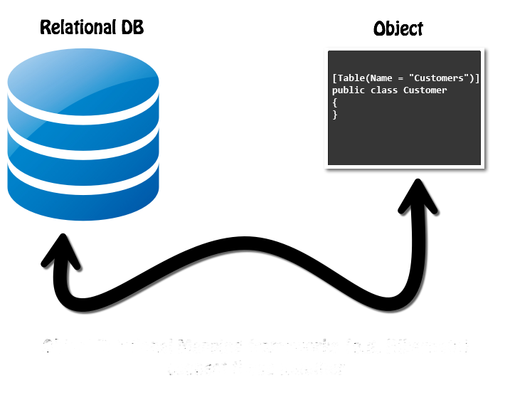
ORM Fundamentals
The ORM Concept, Config, CRUD Operations
SoftUni Team
Technical Trainers
Software University
http://softuni.bg

Slide 37
Table of Contents
ORM Technologies: Basic Concepts
ORM: Advantages and Disadvantages
Writing an ORM Framework from Scratch
Retrieving Entities from Database
Mapping Navigation Properties
Change Tracking
Generating SQL

Slide 38
Questions
sli.do #csharp-db

Slide 39
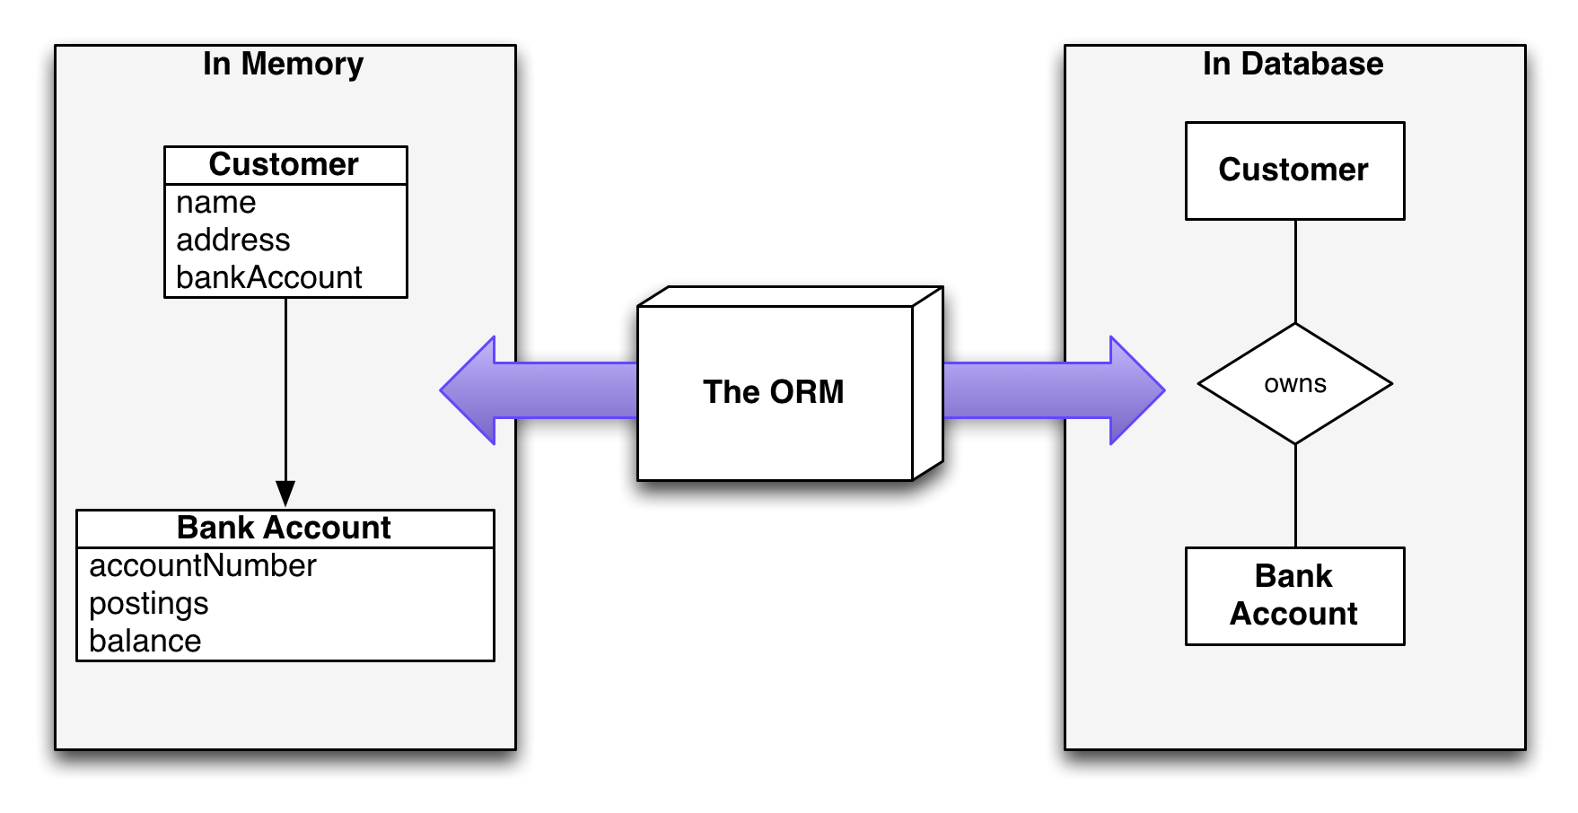
Introduction to ORM
Object-Relational Mapping

Slide 40
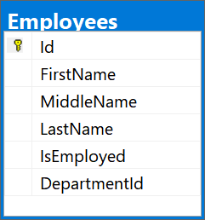
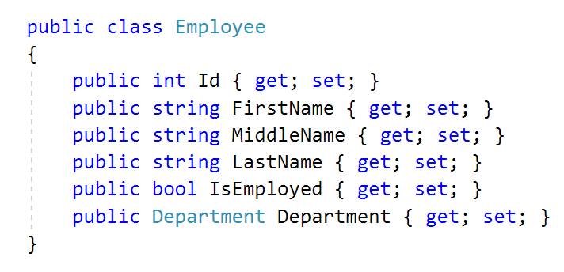
What is ORM?
Object-Relational Mapping (ORM) allows manipulating databases using common classes and objects
Database Tables ➔ C#/Java/etc. classes

Slide 41
ORM Frameworks: Features
ORM frameworks typically provide the following functionality:
Automatically generate SQL to perform data operations
Create object model from database schema (DB First model)
Create database schema from object model (Code First model)
Query data by object-oriented API (e.g. LINQ queries)
database.Employees.Add(new Employee
{
FirstName = “Gosho”,
LastName = “Ivanov”,
IsEmployed = true });
INSERT INTO Employees
(FirstName, LastName, IsEmployed)
VALUES
(‘Gosho’, ‘Ivanov’, 1)

Slide 42
ORM Advantages and Disadvantages
Object-relational mapping (ORM) advantages:
Developer productivity: writing less code
Abstract from differences between object and relational world
Manageability of the CRUD operations for complex relationships
Easier maintainability
Disadvantages:
Reduced performance (due to overhead or autogenerated SQL)
Reduces flexibility (some operations are hard to implement)

Slide 43

Custom ORM Framework
Overview and Features

Slide 44
MiniORM Core: Overview
Designed after Entity Framework Core
Provides LINQ-based data queries and CRUD operations
Change tracking of in-memory objects
Maps navigation properties
Maps collections
One-to-many, Many-to-many, etc.

Slide 45
MiniORM Core Workflow: Overview
Define data model (database-first)
Entity Classes
DbContext (with DbSets)
Initialize DbContext
Using connection string
Query data using context
Manipulate data (add/remove/update entities)
Context gets persisted into database

Slide 46
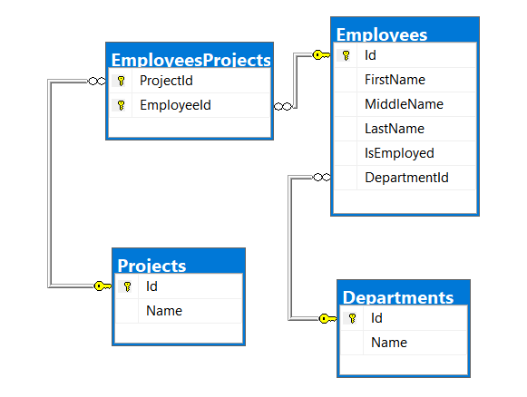
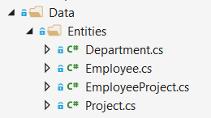
Database First Model
Database First model - models the entity classes after the database

Slide 47
MiniORM Components
The DbContext class
Holds the database connection and the DB Sets
Provides LINQ-based data access
Provides change tracking, and an API for CRUD operations
DB Sets
Hold entities (objects with their attributes and relations)
Each database table is typically mapped to a single C# class

Slide 48
MiniORM Components (2)
Associations (relationship mappings)
An association is a primary key / foreign key-based relationship between two entity classes
Allows navigation from one entity to another
MiniORM supports one-to-one, one-to-many and many-to-many relationships
var courses = student.Courses.Where(…);

Slide 49
Entity Classes
Data Holders

Slide 50
Entity Classes
Entity classes are regular C# classes
Used for storing the data from the DB in-memory

Slide 51
Entity Classes: Navigation Properties
Reference type properties
Point to relevant object, connected by foreign key
Set by the framework
Example: Employee’s Department:
public class Employee {
public int Id { get; set; }
...
[ForeignKey(nameof(Department))]
public int DepartmentId { get; set; }
public Department Department { get; set; }
}

Slide 52
Entity Classes: Navigation Properties (2)
Navigation Properties can also be collections
Usually of type ICollection<T>
Holds all of the objects whose foreign keys are the same as the entity’s primary key
Set by the ORM framework
public class Department
{
public int Id { get; set; }
...
public ICollection<Employee> Employees { get; set; }
}

Slide 53
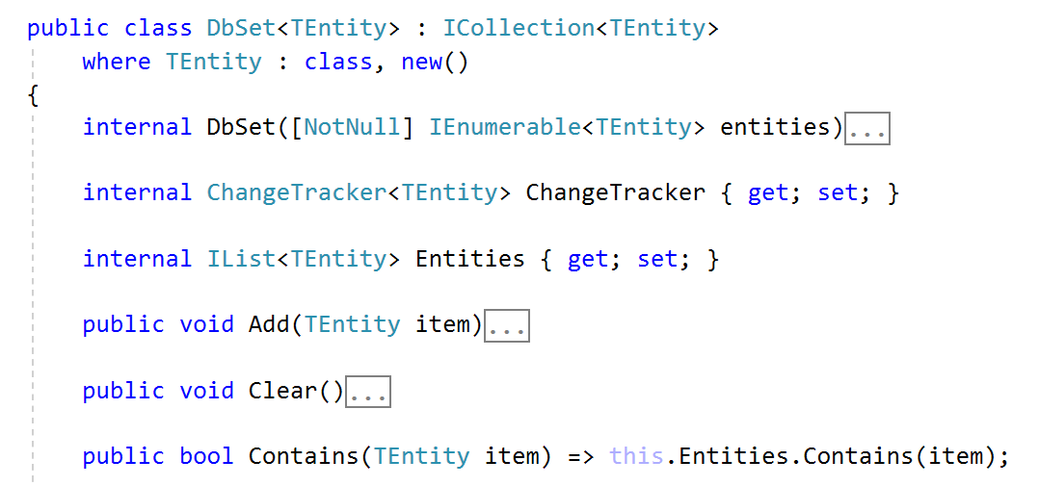
DbSet<T>
Specialized Collections

Slide 54
DbSet<T> Class
Generic collection with additional features
Each DbSet<T> corresponds to a single database table
Inherits from ICollection<T>
foreach-able
Supports LINQ operations
Usually several DbSets are part of a DbContext

Slide 55
DbSet<T> Features
Each DbSet tracks its own entities through a change tracker
Has every other feature of an ICollection<T>
Adding/Updating elements
Removing an entity/a range of entities
Checking for element existence
Accessing the count of elements

Slide 56

DbContext

Slide 57
DbContext Class
Holds several DbSet<T>
Responsible for populating the DbSets
Users create a DbContext, which inherits from DbContext
Using one DbSet per database table
public class SoftUniDbContext : DbContext
{
public DbSet<Employee> Employees { get; }
public DbSet<Department> Departments { get; }
public DbSet<Project> Projects { get; }
public DbSet<EmployeeProject> EmployeesProjects { get; }
}

Slide 58
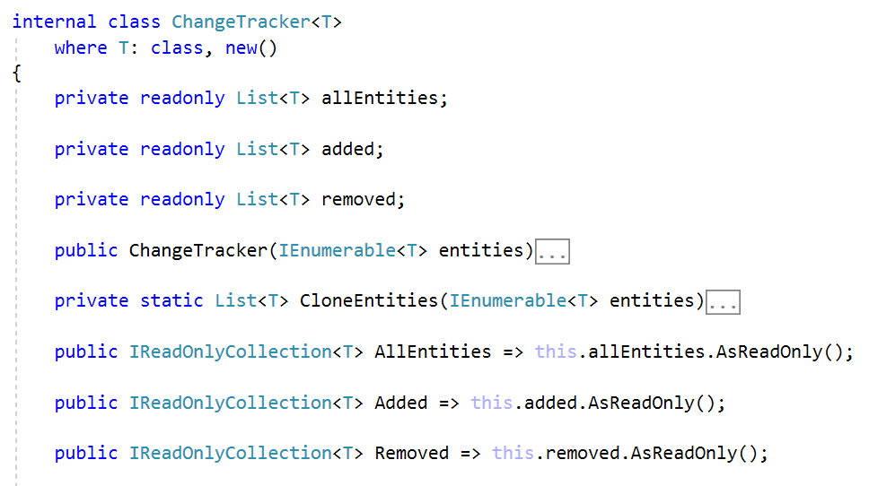
ChangeTracker<T>
Change Tracking Class

Slide 59
ChangeTracker<T>
Container for tracking changes
Holds 3 collections:
All entities
Added entities
Removed entities
Also can track modified entities
Through cloning entities at initialization

Slide 60
ChangeTracker<T>: Cloning Entities
In order to check for entity modification, the change tracker clones all entities on initialization
Cloning process:
Create new blank instance of entity
Find all properties, which are valid SQL types
Set blank instance’s property values to existing entity values

Slide 61
ChangeTracker<T>: Cloning Entities (2)
Cloning Process:
private static List<T> CloneEntities(IEnumerable<T> entities)
{
var clonedEntities = new List<T>();
var propertiesToClone =
// TODO: get properties with SQL types
foreach (var entity in entities) {
var clonedEntity = Activator.CreateInstance<T>();
foreach (var property in propertiesToClone) {
var value = property.GetValue(entity);
property.SetValue(clonedEntity, value);
}
clonedEntities.Add(clonedEntity);
}
return clonedEntities;
}

Slide 62
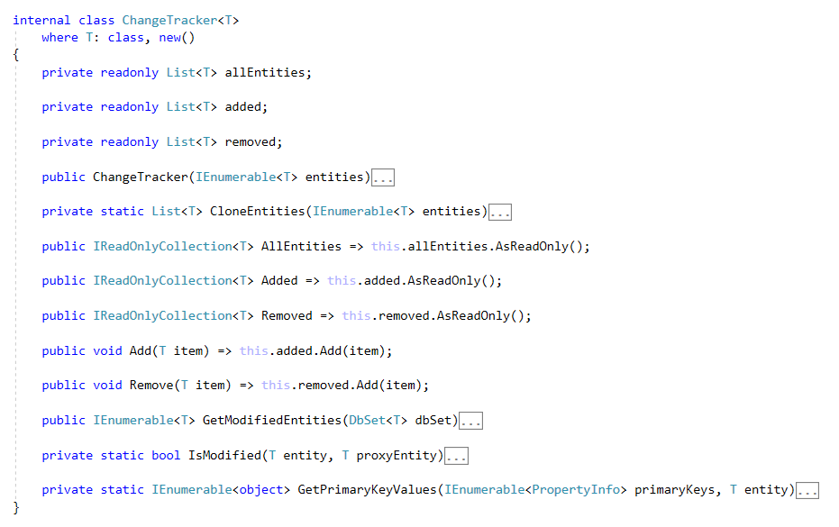
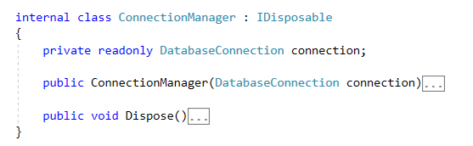
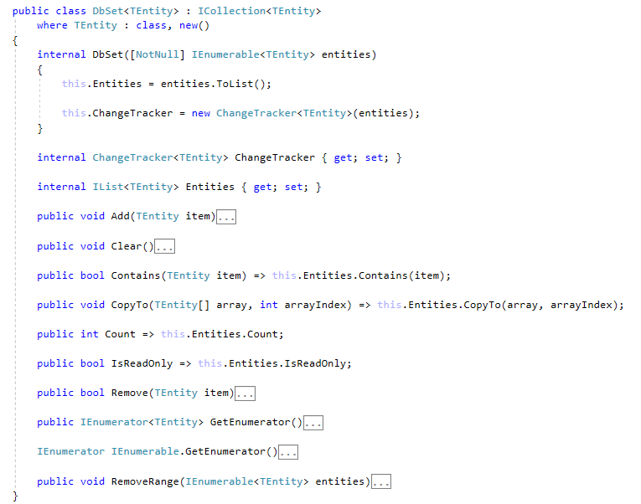
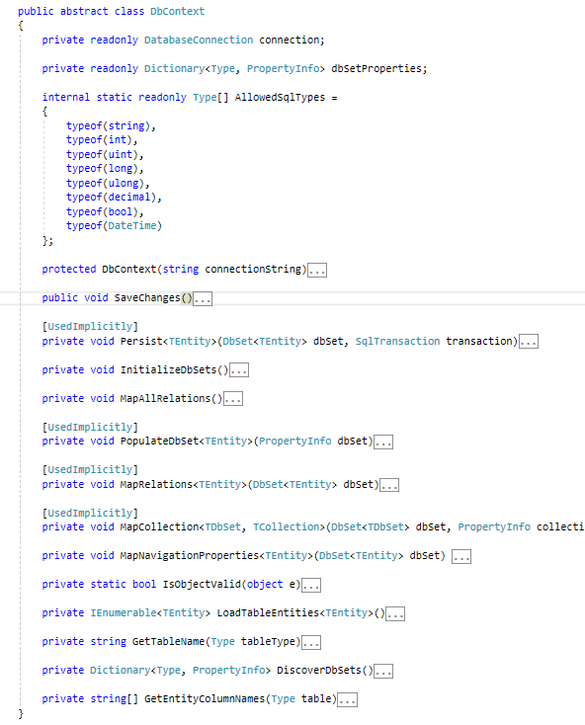
Writing an ORM Framework
Live Demo

Slide 63

Reading Data
Querying the DB using MiniORM

Slide 64
Using DbContext Class
First create instance of the DbContext:
In the constructor you can pass a database connection string
DbContext properties:
All entity classes (tables) are listed as properties
e.g. DbSet<Employee> Employees { get;}
var context = new SoftUniDbContext(connectionString);

Slide 65
Reading Data with LINQ Query
Executing LINQ-to-Entities query over entity:
Employees property in the DbContext:
var context = new SoftUniDbContext(connectionString)
var employees = context.Employees
.Where(e => e.JobTitle == "Design Engineer")
.ToArray();
public class SoftUniDbContext : DbContext
{
public DbSet<Employee> Employees { get; }
public DbSet<Project> Projects { get; }
public DbSet<Department> Departments { get; }
}

Slide 66
Reading Data with LINQ Query
We can also use extension methods for constructing the query
Find element by ID
var context = new SoftUniDbContext(connectionString)
var employees = context.Employees
.Where(c => c.JobTitle == "Design Engineering")
.Select(c => c.FirstName)
.ToList();
var context = new SoftUniEntities()
var project = context.Projects .Single(e => e.Id == 2);
Console.WriteLine(project.Name);

Slide 67
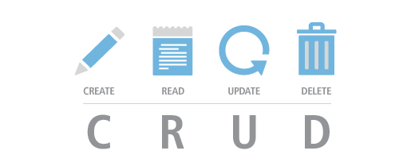
CRUD Operations
With MiniORM

Slide 68
Creating New Entities
To create a new database row use the method Add(…) of the corresponding DbSet:
Create a new Project object
var project = new Project()
{
Name = "Judge System"
};
context.Projects.Add(project);
context.SaveChanges();
Add the object to the DbSet
Execute SQL statements

Slide 69
Updating Existing Entities
DbContext allows modifying entity properties and persisting them in the database
Just load an entity, modify it and call SaveChanges()
The DbContext automatically tracks all changes made on its entity objects
SELECT the first order
Employees employee =
context.Employees.First();
employees.FirstName = "Alex";
context.SaveChanges();
Execute an SQL UPDATE

Slide 70
Deleting Existing Data
Delete is done by Remove() on the specified entity collection
SaveChanges() method performs the delete action in the database
Mark the entity for deleting at the next save
Employees employee =
softUniEntities.Employees.First();
softUniEntities.Employees.Remove(employee);
softUniEntities.SaveChanges();
Execute the SQL DELETE command

Slide 71
Summary
ORM frameworks map database schema to objects in a programming language
LINQ can be used to query the DB through the DB context
…
…
…
var employees = context.Employees
.Where(c => c.JobTitle == "Design Engineering")
.Select(c => c.FirstName)
.ToList();

Slide 72
https://softuni.bg/courses/databases-advanced-entity-framework

Slide 73

Introduction to Entity Framework Core
The ORM Concept, Config, CRUD Operations
SoftUni Team
Technical Trainers
Software University
http://softuni.bg

Slide 74
Table of Contents
Entity Framework Core Overview
Database First Model
CRUD Operations Using Entity Framework Core
Working with LINQ

Slide 75
Have a Question?
sli.do
#csharp-db

Slide 76

Entity Framework Core
Overview and Features

Slide 77
Entity Framework Core: Overview
The standard ORM framework for .NET and .NET Core
Provides LINQ-based data queries and CRUD operations
Automatic change tracking of in-memory objects
Works with many relational databases (with different providers)
Open source with independent release cycle

Slide 78
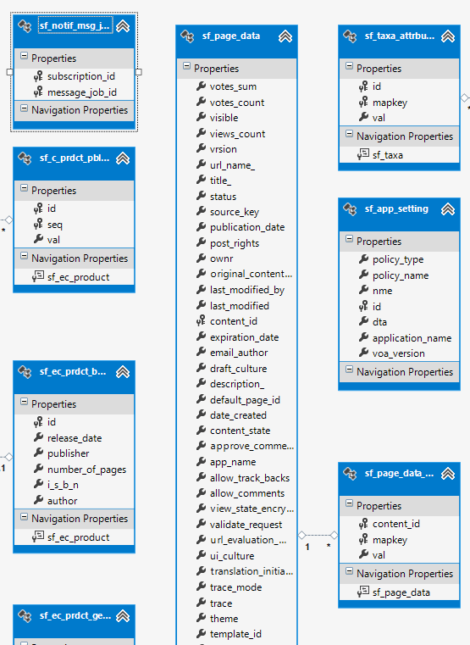
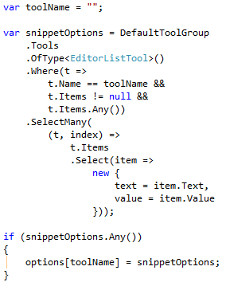
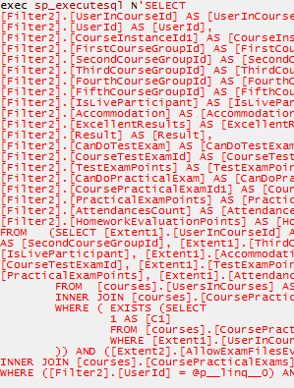
EF Core: Basic Workflow
Define the data model (Code First or Scaffold from DB)
Write & execute query over IQueryable
EF generates & executes an SQL query in the DB

Slide 79
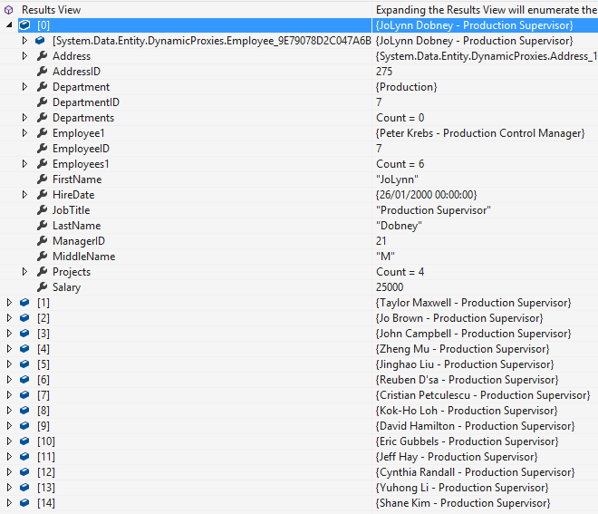
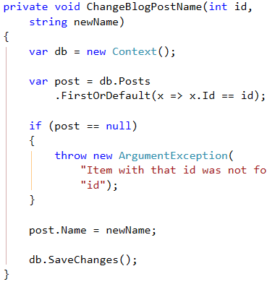
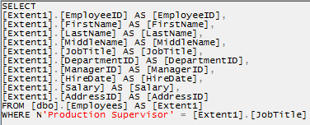
EF Core: Basic Workflow (2)
EF transforms the query results into .NET objects
Modify data with C# code and call "Save Changes()"
Entity Framework generates & executes SQL command to modify the DB

Slide 80
Entity Framework Core: Setup
To add EF Core support to a project in Visual Studio:
Install it from Package Manager Console
EF Core is modular – any data providers must be installed too:
Install-Package Microsoft.EntityFrameworkCore
Install-Package Microsoft.EntityFrameworkCore.SqlServer

Slide 81
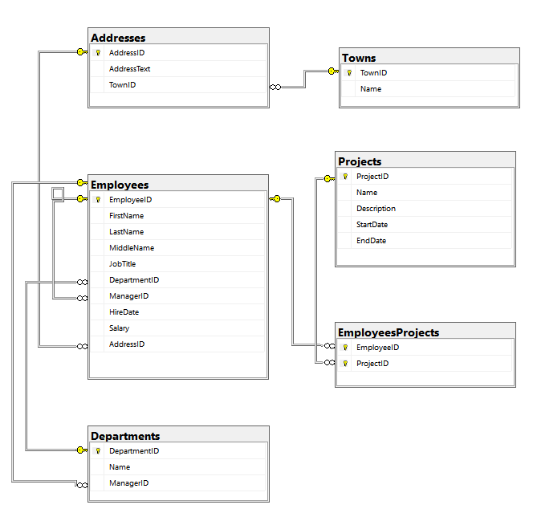
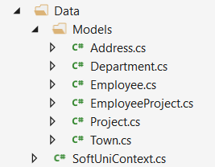
Database First Model
Database First model models the entity classes after the database

Slide 82
Database First Model: Setup
Scaffolding DbContext from DB with Scaffold-DbContext command in Package Manager Console:
Scaffolding requires the following packages beforehand:
Scaffold-DbContext
-Connection "Server=.;Database=…;Integrated Security=True"
-Provider Microsoft.EntityFrameworkCore.SqlServer
-OutputDir Data
Install-Package Microsoft.EntityFrameworkCore.Tools
Install-Package Microsoft.EntityFrameworkCore.SqlServer.Design

Slide 83
EF Components
The DbContext class
Holds the database connection and the entity classes
Provides LINQ-based data access
Provides identity tracking, change tracking, and an API for CRUD operations
Entity classes
Hold entities (objects with their attributes and relations)
Each database table is typically mapped to a single C# class

Slide 84
EF Components (2)
Associations (relationship mappings)
An association is a primary key / foreign key-based relationship between two entity classes
Allows navigation from one entity to another
Concurrency control
Entity Framework uses optimistic concurrency control
No locking by default
Automatic concurrency conflict detection
var courses = student.Courses.Where(…);

Slide 85

Reading Data
Querying the DB using Entity Framework

Slide 86
The DbContext Class
DbContext provides:
CRUD Operations
A way to access entities
Methods for creating new entities (Add() method)
Ability to manipulate database data by modifying objects
Easily navigate through table relations
Executing LINQ queries as native SQL queries
Managing database creation/deletion/migration

Slide 87
Using DbContext Class
First create instance of the DbContext:
In the constructor you can pass a database connection string
DbContext properties:
Database – EnsureCreated/Deleted methods, DB Connection
ChangeTracker – Holds info about the automatic change tracker
All entity classes (tables) are listed as properties
e.g. DbSet<Employee> Employees { get; set; }
var context = new SoftUniDbContext();

Slide 88
Reading Data with LINQ Query
Executing LINQ-to-Entities query over EF entity:
Employees property in the DbContext:
using (var context = new SoftUniEntities())
{
var employees = context.Employees
.Where(e => e.JobTitle == "Design Engineer")
.ToArray();
}
EF translates this to an SQL query
public partial class SoftUniEntities : DbContext
{
public DbSet<Employee> Employees { get; set; }
public DbSet<Project> Projects { get; set; }
public DbSet<Department> Departments { get; set; }
}

Slide 89
Reading Data with LINQ Query
We can also use extension methods for constructing the query
Find element by ID
using (var context = new SoftUniEntities())
{
var employees = context.Employees
.Where(c => c.JobTitle == "Design Engineering")
.Select(c => c.FirstName)
.ToList();
}
ToList() materializes the query
using (var context = new SoftUniEntities())
{
var project = context.Projects.Find(2);
Console.WriteLine(project.Name);
}

Slide 90
LINQ: Simple Operations
Where()
Searches by given condition
First/Last() / FirstOrDefault/LastOrDefault()
Gets the first/last element which matches the condition
Throws InvalidOperationException without OrDefault
Select()
Projects (conversion) collection to another type
OrderBy() / ThenBy() / OrderByDescending()
Orders a collection

Slide 91
LINQ: Simple Operations (2)
Any()
Checks if any element matches a condition
All()
Checks if all elements match a condition
Distinct()
Returns only unique elements
Skip() / Take()
Skips or takes X number of elements

Slide 92
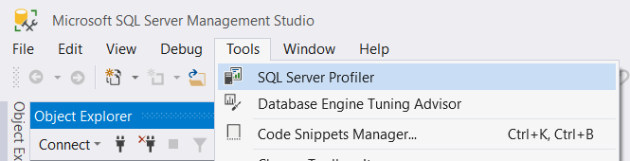
Logging the Native SQL Queries
Queries sent to SQL Server can be monitored with SQL Server Profiler
Included in SQL Server Management Studio:
Queries can also be monitored with Express Profiler
https://expressprofiler.codeplex.com/

Slide 93
CRUD
CRUD Operations
With Entity Framework

Slide 94
Creating New Data
To create a new database row use the method Add(…) of the corresponding DbSet:
Create a new Project object
var project = new Project()
{
Name = "Judge System",
StartDate = new DateTime(2015, 4, 15),
};
context.Projects.Add(project);
context.SaveChanges();
Add the object to the DbSet
Execute SQL statements

Slide 95
Cascading Inserts
We can also add cascading entities to the database:
The Project will be added when the Employee entity (employee) is inserted to the database
Employee employee = new Employee();
employee.FirstName = "Petya";
employee.LastName = "Grozdarska";
employee.Projects.Add(new Project { Name = "SoftUni Conf"} );
softUniEntities.Employees.Add(employee);
softUniEntities.SaveChanges();

Slide 96
Updating Existing Data
DbContext allows modifying entity properties and persisting them in the database
Just load an entity, modify it and call SaveChanges()
The DbContext automatically tracks all changes made on its entity objects
SELECT the first order
Employees employee =
softUniEntities.Employees.First();
employees.FirstName = "Alex";
context.SaveChanges();
Execute an SQL UPDATE

Slide 97
Deleting Existing Data
Delete is done by Remove() on the specified entity collection
SaveChanges() method performs the delete action in the database
Employees employee =
softUniEntities.Employees.First();
softUniEntities.Employees.Remove(employee);
softUniEntities.SaveChanges();
Mark the entity for deleting at the next save
Execute the SQL DELETE command

Slide 98
Summary
…
…
…
ORM frameworks maps database schema to objects in a programming language
Entity Framework Core is the standard .NET ORM
LINQ can be used to query the DB through the DB context

Slide 99
https://softuni.bg/courses/databases-advanced-entity-framework

Slide 100



EF Core Code First
Entity Framework DB From Code
SoftUni Team
Technical Trainers
Software University
http://softuni.bg

Slide 101
Table of Contents
Code First model
EF Core Components
EF Core Configuration
Database Migrations

Slide 102
Have a Question?
sli.do
#csharp-db

Slide 103

Code First Model
Motivation for Code First approach

Slide 104
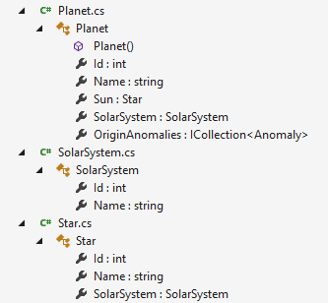
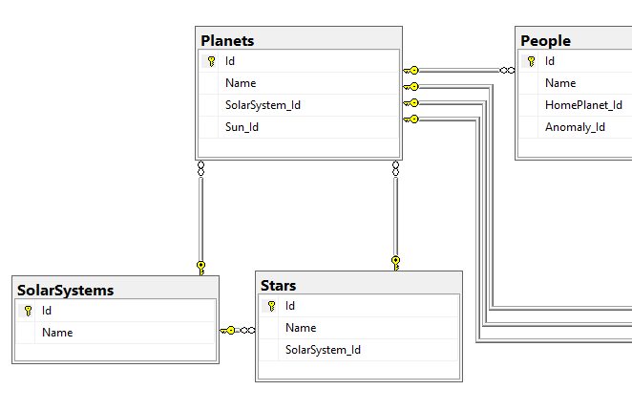
What is the Code First Model?
Code First means to write the .NET classes and let EF Core create the database from the mappings

Slide 105
Why Use Code First?
Write code without having to define mappings in XML or create database tables
Define objects in C# format
Enables database persistence with no configuration
Changes to code can be reflected (migrated) in the schema
Data Annotations or Fluent API describe properties
Key, Required, MinLength, etc.

Slide 106
DbContext
Post
User
EF Core Components
Overview of system objects

Slide 107
Domain Classes (Models)
Bunch of normal C# classes (POCO)
May contain navigation properties for table relationships
Recommended to be in a separate class library
public class PostAnswer
{
public int Id { get; set; }
public string Content { get; set; }
public int PostId { get; set; }
public Post Post { get; set; }
}
Primary key
Foreign key
Navigation property

Slide 108
Domain Classes (Models) (2)
Another example of a domain class (model)
public class Post
{
public int Id { get; set; }
public string Content { get; set; }
public int AuthorId { get; set; }
public User Author { get; set; }
public IList<Reply> Replies { get; set; }
}
Navigation property
One-to-Many relation

Slide 109
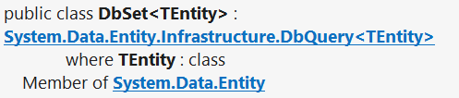
DbSet Type
Maps a collection of entities from a table
Set operations: Add, Attach, Remove, Find
DbContext contains multiple DbSet<T> properties
public DbSet<Post> Posts { get; set; }

Slide 110
The DbContext Class
Usually named after the database e.g. BlogDbContext, ForumDbContext
Inherits from DbContext
Manages model classes using DbSet<T> type
Implements identity tracking, change tracking
Provides API for CRUD operations and LINQ-based data access
Recommended to be in a separate class library
Don't forget to reference the EF Core library + any providers
Use several DbContext if you have too much models

Slide 111
Defining DbContext Class – Example
EF Reference
using Microsoft.EntityFrameworkCore;
using CodeFirst.Data.Models;
public class ForumDbContext : DbContext
{
public DbSet<Category> Categories { get; set; }
public DbSet<Post> Posts { get; set; }
public DbSet<PostAnswer> PostAnswers { get; set; }
public DbSet<User> Users { get; set; }
}
Models Namespace

Slide 112
CRUD Operations with EF Code First
var db = new ForumDbContext();
var category = new Category { Name = "Database course" };
db.Categories.Add(category);
var post = new Post();
post.Title = "Homework Deadline";
post.Content = "Please extend the homework deadline";
post.Type = PostType.Normal;
post.Category = category;
post.Tags.Add(new Tag { Text = "homework" });
post.Tags.Add(new Tag { Text = "deadline" });
db.Posts.Add(post);
db.SaveChanges();

Slide 113


EF Core Configuration
NuGet Packages, Configuration

Slide 114
Code First with EF Core: Setup
To add EF Core support to a project in Visual Studio:
Install it from Package Manager Console
EF Core is modular – any data providers must be installed too
Install-Package Microsoft.EntityFrameworkCore
Install-Package Microsoft.EntityFrameworkCore.SqlServer

Slide 115
How to Connect to SQL Server?
One way to connect is to create a Configuration class with your connection string:
Then add the connection string in the OnConfiguring method in the DbContext class
public static class Configuration
{
public const string ConnectionString = "Server=.;Database=…;";
}
protected override void OnConfiguring(DbContextOptionsBuilder builder)
{
if (!builder.IsConfigured)
builder.UseSqlServer(Configuration.ConnectionString);
}

Slide 116
Fluent API
The OnModelCreating Method let us use the Fluent API to describe our table relations to EF Core
protected override void OnModelCreating(ModelBuilder builder)
{
builder.Entity<Category>()
.HasMany(c => c.Posts)
.WithOne(p => p.Category);
builder.Entity<Post>()
.HasMany(p => p.Replies)
.WithOne(r => r.Post);
builder.Entity<User>()
.HasMany(u => u.Posts)
.WithOne(p => p.Author);
}

Slide 117
Database Connection Workflow
Database Exists?
Yes
Use Database
No
Create Database

Slide 118
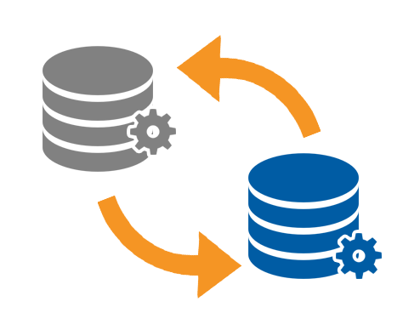
Database Migrations

Slide 119

What are Database Migrations?
Updating database schema without losing data
Adding/dropping tables, columns, etc.
Migrations in EF Core keep their history
Entity Classes, DB Context versions are all preserved
Automatically generated

Slide 120
Migrations in EF Core
To use migrations in EF Core, we use the Add-Migration command from the Package Manager Console
To undo a migration, we use Remove-Migration
Commit changes to the database, using Update-Database
Add-Migration {MigrationName}
Remove-Migration
Update-Database

Slide 121
Summary
…
…
…
Code First increases productivity by centralizing maintenance
Classes represent real world objects with their properties and behaviour
Entity Framework Core uses data classes (POCOs) to represent DB objects
We can use Database Migrations to update our database without losing our data

Slide 122
https://softuni.bg/courses/databases-advanced-entity-framework

Slide 123

Entity Relations
Customizing Entity Models
SoftUni Team
Technical Trainers
Software University
http://softuni.bg

Slide 124
Table of Contents
Object Composition
Navigation Properties
Fluent API
Table Relationships

Slide 125
Have a Question?
sli.do
#csharp-db

Slide 126
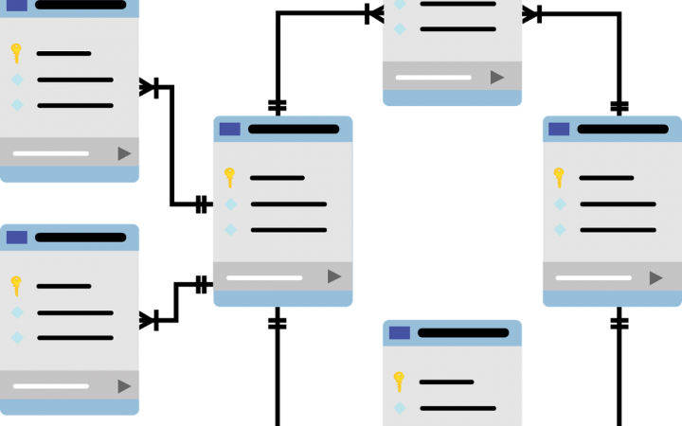
Object Composition
Describing Database Relationships

Slide 127
Object Composition
Object composition denotes a "has-a" relationship
E.g. the car has an engine
Defined in C# by one object having a property that is a reference to another
Person
Dog
Name
Name
Age
Age
Pet

Slide 128
Navigation Properties
Navigation properties create a relationship between entities
Is either an Entity Reference (one to one or zero) or an ICollection (one to many or many to many)
They provide fast querying of related records
Can be modified by directly setting the reference

Slide 129
f() => API
Fluent API
Working with Model Builder

Slide 130
Fluent API
Code First maps your POCO classes to tables using a set of conventions
E.g. property named "Id" maps to the Primary Key
Can be customized using annotations and the Fluent API
Fluent API (Model Builder) allows full control over DB mappings
Custom names of objects (columns, tables, etc.) in the DB
Validation and data types
Define complicated entity relationships

Slide 131
Working with Fluent API
Custom mappings are placed inside the OnModelCreating method of the DB context class
protected override void OnModelCreating(DbModelBuilder builder)
{
builder.Entity<Student>().HasKey(s => s.StudentKey);
}

Slide 132
Fluent API: Renaming DB Objects
Specifying Custom Table name
Custom Column name/DB Type
modelBuilder.Entity<Order>()
.ToTable("OrderRef", "Admin");
Optional schema name
modelBuilder.Entity<Student>()
.Property(s => s.Name)
.HasColumnName("StudentName")
.HasColumnType("varchar");

Slide 133
Fluent API: Column Attributes
Explicitly set Primary Key
Other column attributes
modelBuilder
.Entity<Student>().HasKey("StudentKey");
modelBuilder.Entity<Person>()
.Property(p => p.FirstName)
.IsRequired()
.HasMaxLength(50)
modelBuilder.Entity<Post>()
.Property(p => p.LastUpdated)
.ValueGeneratedOnAddOrUpdate()

Slide 134
Fluent API: Miscellaneous Config
Do not include property in DB (e.g. business logic properties)
Disabling cascade delete
If a FK property is non-nullable, cascade delete is on by default
modelBuilder
.Entity<Department>().Ignore(d => d.Budget);
modelBuilder.Entity<Course>()
.HasRequired(t => t.Department)
.WithMany(t => t.Courses)
.HasForeignKey(d => d.DepartmentID)
.OnDelete(DeleteBehavior.Restrict);
Throws exception on delete

Slide 135
Specialized Configuration Classes
Mappings can be placed in entity-specific classes
Include in OnModelCreating:
public class StudentConfiguration
: IEntityTypeConfiguration<Student>
{
public void Configure(EntityTypeBuilder<Student> builder)
{
builder.HasKey(c => c.StudentKey);
}
}
Specify target model
builder.ApplyConfiguration(new StudentConfiguration());

Slide 136

Table Relationships
Expressed as Properties and Attributes

Slide 137
One-to-Zero-or-One
Expressed in SQL Server as a shared primary key
Relationship direction must be explicitly specified with a ForeignKey attribute
ForeignKey is placed above the key property and contains the name of the navigation property and vice versa
Student
Address

Slide 138
One-to-Zero-or-One: Implementation
Using the ForeignKey Attribute
public class Student
{
[Key]
public int Id { get; set; }
public string Name { get; set; }
public int AddressId { get; set; }
[ForeignKey("Address")]
public Address Address { get; set; }
}
Attributes

Slide 139
One-to-Zero-or-One: Implementation (2)
Using the ForeignKey Attribute
public class Address
{
public int Id { get; set; }
public string Text { get; set; }
public int StudentId { get; set; }
[ForeignKey(nameof(Student))]
public Student Student { get; set; }
}

Slide 140
One-to-Zero-or-One: Fluent API
HasOne ➔ WithOne
If StudentId property is nullable (int?), relation becomes One-To-Zero-Or-One
modelBuilder.Entity<Address>()
.HasOne(a => a.Student)
.WithOne(s => s.Address)
.HasForeignKey(a => a.StudentId);
Address contains FK to Student

Slide 141
One-to-Many
Most common type of relationship
Implemented with a collection inside the parent entity
The collection should be initialized in the constructor!
Employee
Department
Employee
Employee

Slide 142
One-to-Many: Implementation
Department has many employees
public class Department
{
public int Id { get; set; }
public string Name { get; set; }
public ICollection<Employee> Employees { get; set; }
}

Slide 143
One-to-Many: Implementation (2)
Employees have one department
public class Employee
{
public int Id { get; set; }
public string FirstName { get; set; }
public string LastName { get; set; }
public int DepartmentId { get; set; }
public Department Department { get; set; }
}

Slide 144
One-to-Many: Fluent API
HasMany ➔ WithOne
modelBuilder.Entity<Post>()
.HasMany(p => p.Comments)
.WithOne(c => c.Post)
.HasForeignKey(c => c.PostId);
modelBuilder.Entity<Employee>()
.HasMany(e => e.Addresses)
.WithOne(a => a.Employee)
.HasForeignKey(a => a.EmployeeId);

Slide 145
Many-to-Many
Requires a join entity (separate class) in EF Core
Implemented with collections in each entity, referring the other
Student
Course
Student
Course
Student

Slide 146
Many-to-Many Implementation (1)
public class Course
{
public string Name { get; set; }
public ICollection<StudentCourse> StudentsCourses { get; set; }
}
public class Student
{
public string FirstName { get; set; }
public string LastName { get; set; }
public ICollection<StudentCourse> StudentsCourses { get; set; }
}

Slide 147
Many-to-Many Implementation (2)
EF Core requires a Join Entity
public class StudentCourse
{
public int StudentId { get; set; }
public Student Student { get; set; }
public int CourseId { get; set; }
public Course Course { get; set; }
}

Slide 148
Many-to-Many: Fluent API
Mapping both sides of relationship
modelBuilder.Entity<StudentCourse>()
.HasKey(sc => new { sc.StudentId, sc.CourseId });
builder.Entity<StudentCourse>()
.HasOne(sc => sc.Student)
.WithMany(s => s.StudentCourses)
.HasForeignKey(sc => sc.StudentId);
builder.Entity<StudentCourse>()
.HasOne(sc => sc.Course)
.WithMany(s => s.StudentCourses)
.HasForeignKey(sc => sc.CourseId);
Composite Primary Key

Slide 149
Multiple Relations
When two entities are related by more than one key
Entity Framework needs help from Inverse Properties
Place of Birth
Town
Person
Current Residence
Town

Slide 150
Multiple Relations Implementation
Person Domain Model – defined as usual
public class Person
{
public int Id { get; set; }
public string Name { get; set; }
public Town PlaceOfBirth { get; set; }
public Town CurrentResidence { get; set; }
}

Slide 151
Multiple Relations Implementation (2)
Town Domain Model
public class Town
{
public int Id { get; set; }
public string Name { get; set; }
[InverseProperty("PlaceOfBirth")]
public ICollection<Person> Natives { get; set; }
[InverseProperty("CurrentResidence")]
public ICollection<Person> Residents { get; set; }
}
Point towards related property

Slide 152
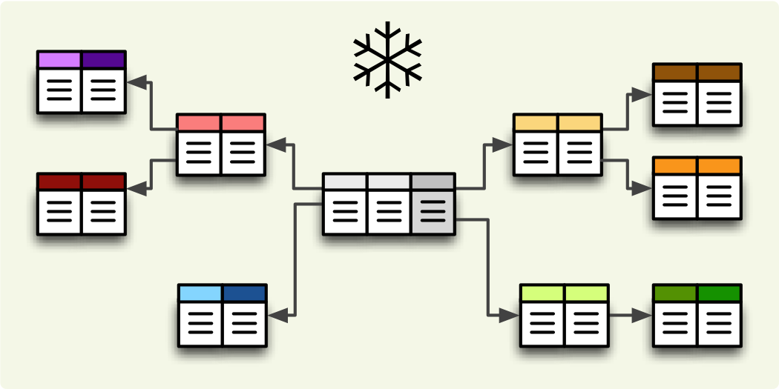
Filtering and Aggregating Tables
Select, Join and Group Data Using LINQ

Slide 153
Good Reasons to Use Select
Limit network traffic by reducing the queried columns
Syntax:
SQL Server Profiler
var employeesWithTown = context
.Employees
.Select(employee => new
{
EmployeeName = employee.FirstName,
TownName = employee.Address.Town.Name
});
SELECT [employee].[FirstName] AS [EmployeeName], [employee.Address.Town].[Name] AS [TownName]
FROM [Employees] AS [employee]
LEFT JOIN [Addresses] AS [employee.Address] ON [employee].[AddressID] = [employee.Address].[AddressID]
LEFT JOIN [Towns] AS [employee.Address.Town] ON [employee.Address].[TownID] = [employee.Address.Town].[TownID]

Slide 154
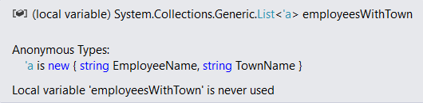
Good Reasons not to Use Select
Data that is selected is not of the initial entity type
Anonymous type, generated at runtime
Data cannot be modified (updated, deleted)
Entity is of a different type
Not associated with the context anymore

Slide 155
Joining Tables in EF: Using Join()
Join tables in EF with LINQ / extension methods on IEnumerable<T> (like when joining collections)
var employees =
softUniEntities.Employees.Join(
softUniEntities.Departments,
(e => e.DepartmentID),
(d => d.DepartmentID),
(e, d) => new {
Employee = e.FirstName,
JobTitle = e.JobTitle,
Department = d.Name
}
);

Slide 156
Grouping Tables in EF
Grouping also can be done by LINQ
The same way as with collections in LINQ
Grouping with LINQ:
Grouping with extension methods:
var groupedEmployees =
from employee in softUniEntities.Employees
group employee by employee.JobTitle;
var groupedCustomers = softUniEntities.Employees
.GroupBy(employee => employee.JobTitle);

Slide 157

Result Models
Simplifying Models

Slide 158
Result Models
Select(), GroupBy() can work with custom classes
Allows you to pass them to methods and use them as a return type
Requires some extra code (class definition)
Sample Result Model:
public class UserResultModel
{
public string FullName { get; set; }
public string Age { get; set; }
}

Slide 159
Result Models (2)
Assign the fields as you would with an anonymous object:
The new type can be used in a method signature:
var currentUser = context.Users
.Where(u => u.Id == 8)
.Select(u => new UserResultModel
{
FullName = u.FirstName + " " + u.LastName,
Age = u.Age
})
.SingleOrDefault();
public UserResultModel GetUserInfo(int Id) { … }

Slide 160

Attributes
Custom Entity Framework Behavior

Slide 161
Attributes
EF Code First provides a set of DataAnnotation attributes
You can override default Entity Framework behavior
To access nullability and size of fields:
To access schema customizations:
For a full set of configuration options you need the Fluent API
using System.ComponentModel.DataAnnotations;
using System.ComponentModel.DataAnnotations.Schema;

Slide 162
Key Attributes
[Key] – explicitly specify primary key
When your PK column doesn’t have an "Id" suffix
Composite key is only defined using Fluent API for now
[Key]
public int StudentKey { get; set; }
builder.Entity<EmployeesProjects>()
.HasKey(k => new { k.EmployeeId, k.ProjectId });

Slide 163
Key Attributes (2)
ForeignKey – explicitly link navigation property and foreign key property within the same class
Works in either direction (FK to navigation property or navigation property to FK)
public class Client
{
…
[ForeignKey("Order")]
public int OrderRefId { get; set; }
public Order Order { get; set; }
}

Slide 164
Renaming Objects
Table – manually specify the name of the table in the DB
[Table("StudentMaster")]
public class Student
{
…
}
[Table("StudentMaster", Schema = "Admin")]
public class Student
{
…
}

Slide 165
Renaming Objects (2)
Column – manually specify the name of the column in the DB
You can also specify order and explicit data type
public class Student
{
…
[Column("StudentName", Order = 2, TypeName="varchar(50)")]
public string Name { get; set; }
}
Optional parameters

Slide 166
Entity Validation
Required – mark a nullable property as NOT NULL in the DB
Will throw an exception if not set to a value
Non-nullable types (e.g. int) will not throw an exception (will be set to language-specific default value)
MinLength – specifies min length of a string (client validation)
MaxLength / StringLength – specifies max length of a string (both client and DB validation)
Range – set lower and/or upper limits of numeric property (client validation)

Slide 167
Other Attributes
Index – create index for column
Primary key will always have an index
NotMapped – property will not be mapped to a column
For business logic properties
builder.Entity<Car>()
.HasIndex(u => u.RegistrationNumber)
.IsUnique();

Slide 168
Validation Method
Add using:
Create following method to validate entities:
using System.ComponentModel.DataAnnotations;
private bool IsValid(object obj)
{
var validationContext = new ValidationContext(obj);
var validationResults = new List<ValidationResult>();
return Validator.TryValidateObject(obj, validationContext, validationResults, true);
}

Slide 169

Shadow Properties

Slide 170
Shadow Properties
Shadow properties are not defined in your .NET entity class
They are useful when there is data in the database that should not be exposed on the mapped entity types.
Configure shadow property:
Change value of shadow property:
builder.Entity<Project>() .Property<DateTime>("LastUpdated");
context.Entry(Project).Property("LastUpdated")
.CurrentValue = DateTime.Now;

Slide 171
Summary
…
…
…
Objects can be composed from other objects to represent complex relationships
Navigation properties speed up the traversal of related entities

Slide 172
Summary
…
…
…
The Fluent API gives us full control over Entity Framework object mappings
Information overhead can be limited by selecting only the needed properties
ResultModels can be used to move aggregated data between methods
Attributes can be used to express special table relationships and to customize entity behaviour

Slide 173
https://softuni.bg/courses/databases-advanced-entity-framework

Slide 174

EF Advanced Querying
Performance Optimizations
SoftUni Team
Technical Trainers
Software University
http://softuni.bg

Slide 175
Table of Contents
Native SQL Queries
Object State
Batch Operations
Stored Procedures
Concurrency
Cascade Operations

Slide 176
Have a Question?
sli.do
#CSharpDB

Slide 177

Executing Native SQL Queries
Parameterless and Parameterized

Slide 178
Executing Native SQL Queries
Executing a native SQL query in EF Core directly:
Limitations:
JOIN statements don’t get mapped to the entity class
Required columns must always be selected
Target table must be the same as the DbSet
SQL statements other than SELECT are recognized automatically as non-composable. As a consequence, the full results of stored procedures are always returned to the client and any LINQ operators applied after FromSqlRaw are evaluated in-memory.
var query = "SELECT * FROM Employees";
var employees = db.Employees
.FromSqlRaw(query)
.ToArray();

Slide 179
Native SQL Queries with Parameters
Native SQL queries can also be parameterized:
var context = new SoftUniDbContext();
string nativeSQLQuery =
"SELECT FirstName, LastName, JobTitle" +
"FROM dbo.Employees WHERE JobTitle = {0}";
var employees = context.Employees.FromSqlRaw(
nativeSQLQuery, "Marketing Specialist");
foreach (var employee in employees)
{
Console.WriteLine(employee);
}
Parameter placeholder
Parameter value

Slide 180
Interpolation in SQL Queries
FromSqlInterpolated allows string interpolation syntax
var context = new SoftUniDbContext();
string jobTitle = "Marketing Specialist";
string nativeSQLQuery =
"SELECT FirstName, LastName, JobTitle" +
"FROM dbo.Employees WHERE JobTitle = {jobTitle}";
var employees = context.Employees.FromSqlInterpolated(
nativeSQLQuery)
foreach (var employee in employees)
{
Console.WriteLine(employee);
}
Interpolated parameter

Slide 181

State Prediction
Measurement Update
Object State Tracking

Slide 182
Attaching and Detaching Objects
In Entity Framework, objects can be:
Attached to the object context (tracked object)
Detached from an object context (untracked object)
Attached objects are tracked and managed by the DbContext
SaveChanges() persists all changes in DB
Detached objects are not referenced by the DbContext
Behave like a normal objects, which are not related to EF

Slide 183
Attaching Detached Objects
When a query is executed inside a DbContext, the returned objects are automatically attached to it
When a context is destroyed, all objects in it are automatically detached
E.g. in Web applications between requests
You might later on attach objects that have been previously detached to a new context

Slide 184
Detaching Objects
When is an object detached?
When we get the object from a DbContext and then Dispose it
Manually: by setting the EntryState to Detached
Employee GetEmployeeById(int id)
{
using (var SoftUniDbContext = new SoftUniDbContext())
{
return SoftUniDbContext.Employees
.First(p => p.EmployeeID == id);
}
}
Returned employee is detached

Slide 185
Attaching Objects
When we want to update a detached object we need to reattach it and then update it: change to Attached state
void UpdateName(Employee employee, string newName)
{
using (var SoftUniDbContext = new SoftUniDbContext())
{
var entry = SoftUniDbContext.Entry(employee);
entry.State = EntityState.Added;
employee.FirstName = newName;
SoftUniDbContext.SaveChanges();
}
}

Slide 186

Stored Procedures

Slide 187
Executing a Stored Procedure
Stored Procedures can be executed via SQL
CREATE PROCEDURE UpdateAge @param int
AS
UPDATE Employees SET Age = Age + @param;
var ageParameter = new SqlParameter("@age", 5);
var query = "EXEC UpdateAge @age";
context.Database.ExecuteSqlCommand(query, ageParameter);
Notes:
More information on how tom make stored procedures for Insert, update and delete - https://msdn.microsoft.com/en-us/library/dn468673(v=vs.113).aspx

Slide 188
BULK
Bulk Operations
Multiple Update and Delete in Single Query

Slide 189
EntityFramework-Plus
Entity Framework does not support bulk operations
Z.EntityFramework.Plus gives you the ability to perform bulk update/delete of entities
Install Z.EntityFramework.Plus.EFCore as a NuGet package
Read more: https://entityframework-plus.net
Install-Package Z.EntityFramework.Plus.EFCore
Notes:
https://weblogs.asp.net/pwelter34/entity-framework-batch-update-and-future-queries

Slide 190
Bulk Delete
Delete all users where FirstName matches given string
context.Employees
.Where(u => u.FirstName == "Pesho")
.Delete();
DELETE [dbo].[Employees]
FROM [dbo].[Employees] AS j0 INNER JOIN (
SELECT
[Extent1].[Id] AS [Id]
FROM [dbo].[Employees] AS [Extent1].[Name]
WHERE N’Pesho' = [Extent1].[Name]
) AS j1 ON (j0.[Id] = j1.[Id])

Slide 191
Bulk Update: Syntax
Update all Employees with name “Nasko” to “Plamen”
Update all Employees’ age to 99 who have the name “Plamen”
context.Employees
.Where(t => t.Name == "Nasko")
.Update(u => new Employee() {Name = "Plamen"});
IQueryable<Employee> employees = context.Employees
.Where(employee => employee.Name == "Plamen");
employees.Update(employee => new Employee() { Age = 99 });

Slide 192
Loading…
Types of Loading
Lazy, Eager and Explicit Loading

Slide 193
Explicit Loading
Explicit loading loads all records when they’re needed
Performed with the Collection().Load() method
var employee = context.Employees.First();
context.Entry(employee)
.Reference(e => e.Department)
.Load();
context.Entry(employee)
.Collection(e => e.EmployeeProjects)
.Load();

Slide 194
Eager Loading
Eager loading loads all related records of an entity at once
Performed with the Include method
context.Towns.Include("Employees");
context.Towns.Include(town => town.Employees);
context.Employees
.Include(employee => employee.Address)
.ThenInclude(address => address.Town)

Slide 195
Lazy Loading
Lazy Loading delays loading of data until it is used
EF Core enables lazy-loading for any navigation property that can be overridden
Offers better performance in certain cases
Less RAM usage
Smaller result sets returned

Slide 196
Lazy Loading Proxies
Install Lazy Loading Proxies
Enable the package
Install-Package Microsoft.EntityFrameworkCore.Proxies
void OnConfiguring (DbContextOptionsBuilder options)
{
options
.UseLazyLoadingProxies()
.UseSqlServer(myConnectionString);
}

Slide 197

Concurrency Checks

Slide 198
Optimistic Concurrency Control in EF
EF Core runs in optimistic concurrency mode (no locking)
By default the conflict resolution strategy in EF is "last one wins"
The last change overwrites all previous concurrent changes
Enabling "first wins" strategy for certain property in EF:
[ConcurrencyCheck]

Slide 199
Last One Wins – Example
var contextFirst = new SoftUniDbContext();
var lastProjectFirstUser = contextFirst.Projects.First();
lastProjectFirstUser.Name = "Changed by the First User";
// The second user changes the same record
var contextSecondUser = new SoftUniDbContext();
var lastProjectSecond = contextSecondUser.Projects.First();
lastProjectSecond.Name = "Changed by the Second User";
// Conflicting changes: last wins
contextFirst.SaveChanges();
contextSecondUser.SaveChanges();
Second user wins

Slide 200
First One Wins – Example
var context = new SoftUniDbContext();
var lastTownFirstUser = contextFirst.Towns.First();
lastTownFirstUser.Name = "First User";
var contextSecondUser = new SoftUniDbContext();
var lastTownSecondUser = contextSecondUser.Towns.First();
lastTownSecondUser.Name = "Second User";
context.SaveChanges();
contextSecondUser.SaveChanges();
Changes get saved
DbUpdateConcurrencyException

Slide 201

Cascade Operations
Deleting Related Entities

Slide 202
Cascade Delete Scenarios
Required FK with cascade delete set to true, deletes everything related to the deleted property
Required FK with cascade delete set to false, throws exception (it cannot leave the navigational property with no value)
Optional FK with cascade delete set to true, deletes everything related to the deleted property.
Optional FK with cascade delete set to false, sets the value of the FK to NULL

Slide 203
Cascade Delete with Fluent API
Using OnDelete with DeleteBehavior Enumeration:
DeleteBehavior.Cascade
Deletes related entities (default for required FK)
DeleteBehavior.Restrict
Throws exception on delete
DeleteBehavior.ClientSetNull
Default behavior for optional FK (does not affect database)
DeleteBehavior.SetNull
Sets the property to null (affects database)

Slide 204
Cascade Delete with Fluent API (2)
Cascade delete syntax:
modelBuilder.Entity<User>()
.HasMany(u => u.Replies)
.WithOne(a => a.Author)
.OnDelete(DeleteBehavior.Restrict);
modelBuilder.Entity<User>()
.HasMany(u => u.Replies)
.WithOne(a => a.Author)
.OnDelete(DeleteBehavior.Cascade);

Slide 205
Summary
…
…
…
Databases can be accessed directly with SQL queries from C# code
EF keeps track of the model state
Entity Framework-Plus lets you bundle update and delete operations
With multiple users, concurrency of operations must be observed
Cascade delete is on by default

Slide 206
https://softuni.bg/courses/databases-advanced-entity-framework

Slide 207
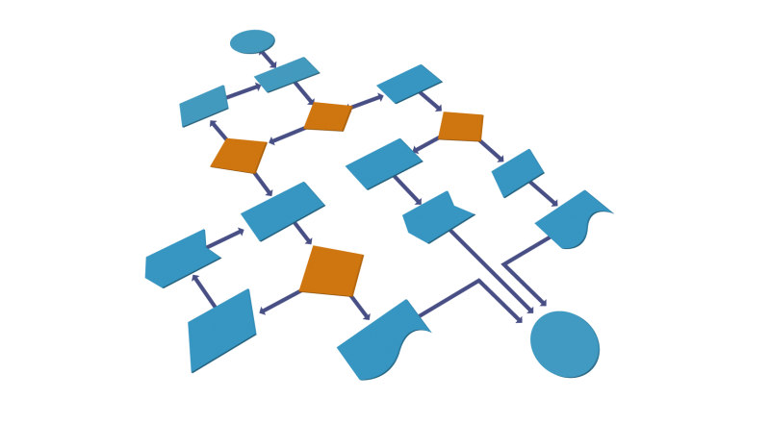


C# Auto Mapping Objects
Manual Mapping
and AutoMapper Library
SoftUni Team
Technical Trainers
Software University
http://softuni.bg

Slide 208
Table of Contents
DTO Definition
Manual Mapping
AutoMapper

Slide 209
Have a Question?
sli.do
#csharp-db

Slide 210
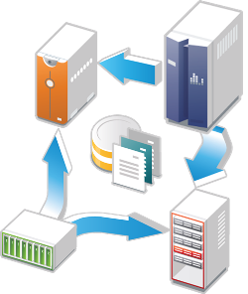
Data Transfer Objects
Definition and Usage

Slide 211
What is a Data Transfer Object?
A DTO is an object that carries data between processes
Used to aggregate only the needed information in a single call
Example: In web applications, between the server and client
Doesn't contain any logic – only stores values
public class ProductDTO
{
public string Name { get; set; }
public int StockQty { get; set; }
}

Slide 212
DTO Usage Scenarios
Remove circular references
Hide particular properties that clients are not supposed to view
Omit some properties in order to reduce payload size
Flatten object graphs that contain nested objects to make them more convenient for clients
Decouple your service layer from your database layer

Slide 213
Manual Mapping
Relationship Diagram
Product
Storage
ProductId
Name
Description
StorageId
Name
Location
ProductStock
Quantity
ProductId
StorageId
Additional data
in mapping table

Slide 214
Manual Mapping (2)
Get product name and stock quantity in a new DTO object
var product = context.Products.FirstOrDefault();
var productDto = new ProductDTO
{
Name = product.Name,
StockQty = product.ProductStocks
.Sum(ps => ps.Quantity)
};
Aggregate information from mapping table

Slide 215

AutoMapper Library
Automatic Translation of Domain Objects

Slide 216
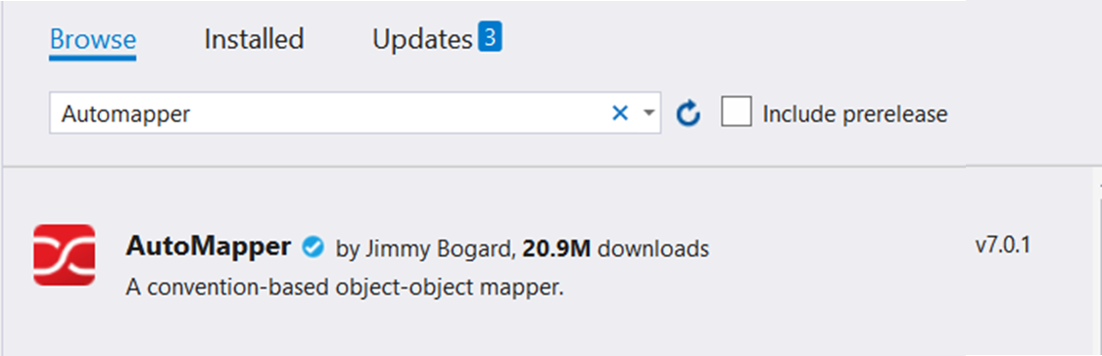
What is AutoMapper?
Library to eliminate manual mapping code
Available as a NuGet Package
Official GitHub Page
Install-Package AutoMapper

Slide 217
Initialization and Configuration
AutoMapper offers a static service for use and configuration
Add mappings between objects and DTOs
Properties will be mapped by name
Source
Mapper.Initialize(cfg => cfg.CreateMap<Product, ProductDTO>());
Target
var product = context.Products.FirstOrDefault();
ProductDTO dto = Mapper.Map<ProductDTO>(product);

Slide 218
Multiple Mappings
You can configure all mapping configurations at once
Mapper.Initialize(cfg =>
{
cfg.CreateMap<Product, ProductDTO>();
cfg.CreateMap<Order, OrderDTO>();
cfg.CreateMap<Client, ClientDTO>();
cfg.CreateMap<SupportTicket, TicketDTO>();
});

Slide 219
Custom Member Mapping
Map properties that don't match naming convention
Destination property
Mapper.Initialize(cfg =>
cfg.CreateMap<Product, ProductDTO>()
.ForMember(dto => dto.StockQty,
opt => opt.MapFrom(src =>
src.ProductStocks.Sum(p => p.Quantity))));
Source

Slide 220
Flattening Complex Properties
AutoMapper can also be used to flatten complex properties
Mapper.Initialize(cfg =>
cfg.CreateMap<Event, CalendarEventViewModel>()
.ForMember(dest => dest.Date,
opt => opt.MapFrom(src => src.Date.Date))
.ForMember(dest => dest.Hour,
opt => opt.MapFrom(src => src.Date.Hour))
.ForMember(dest => dest.Minute,
opt => opt.MapFrom(src => src.Date.Minute)));

Slide 221
Flattening Complex Objects
Flattening of related objects is automatically supported
AutoMapper understands ClientName is the Name of a Client
public class OrderDTO
{
public string ClientName { get; set; }
public decimal Total { get; set; }
}
Mapper.Initialize(cfg => cfg.CreateMap<Order, OrderDTO>());
OrderDTO dto = Mapper.Map<Order, OrderDTO>(order);

Slide 222
Unflattening Complex Objects
Unflattening of related objects is automatically supported
AutoMapper understands ClientName is the Name of a Client, but to unflatten it, it needs ReverseMap
public class OrderDTO
{
public string ClientName { get; set; }
public decimal Total { get; set; }
}
Mapper
.Initialize(cfg => cfg.CreateMap<Order, OrderDTO>()
.ReverseMap());

Slide 223
Mapping Collections
EF Core uses IQueryable<T> for all DB operations
AutoMapper can work with IQueryable<T> to map classes
Using AutoMapper to map an entire DB collection:
Works like an automatic .Select()
EF Core generates optimized SQL (like with an anonymous object)
var posts = context.Posts
.Where(p => p.Author.Username == "gosho")
.ProjectTo<PostDto>()
.ToArray();
IQueryable<Post>
IQueryable<PostDto>

Slide 224
AutoMapper.Collection
Adds ability to map collections to existing collections without re-creating the collection object
Will Add/Update/Delete items from a preexisting collection object based on user defined equivalency between the collection's generic item type from the source collection and the destination collection
Mapper
.Initialize(cfg => cfg.AddCollectionMappers());

Slide 225
AutoMapper.Collection.EntityFrameworkCore
Automapper.Collection.EntityFrameworkCore will help you mapping of EntityFrameowrk Core DbContext-object
Comparing to a single existing Entity for updating
Mapper.Initialize(cfg =>
{
cfg.AddCollectionMappers();
cfg.SetGeneratePropertyMaps
<GenerateEntityFrameworkCorePrimaryKeyPropertyMaps<Context>>();
// Configuration code
});
dbContext.Orders.Persist().InsertOrUpdate<OrderDTO>(newOrderDto);
dbContext.Orders.Persist().InsertOrUpdate<OrderDTO>(existingOrderDto);
dbContext.Orders.Persist().Remove<OrderDTO>(deletedOrderDto);
dbContext.SubmitChanges();

Slide 226
Inheritance Mapping
Inheritance chains are defined via Include()
AutoMapper chooses the most appropriate child class
Register with parent
Mapper.Initialize(cfg => {
cfg.CreateMap<Order, OrderDto>()
.Include<OnlineOrder, OnlineOrderDto>()
.Include<MailOrder, MailOrderDto>();
cfg.CreateMap<OnlineOrder, OnlineOrderDto>();
cfg.CreateMap<MailOrder, MailOrderDto>();
});
Order
OnlineOrder
MailOrder
Child mapping

Slide 227
Mapping Profiles
We can extract our configuration to a class (called a profile)
Using our configuration class:
public class ForumProfile : Profile
{
public ForumProfile()
{
CreateMap<Post, PostDto>();
CreateMap<Category, CategoryDto>();
}
}
using AutoMapper;
Mapper.Initialize(cfg => cfg.AddProfile<ForumProfile>());

Slide 228
Summary
…
…
…
To reduce round-trip latency and payload size, data is transformed into a DTO
AutoMapper is a library that automates this process and reduces boilerplate code
Complex objects can be flattened to fractions of their sizes

Slide 229
https://softuni.bg/courses/databases-advanced-entity-framework

Slide 230

External Format Processing
Parsing JSON, JSON.NET
SoftUni Team
Technical Trainers
Software University
http://softuni.bg

Slide 231
Table of Contents
JSON Data Format
Processing JSON
JSON.NET

Slide 232
Have a Question?
sli.do
#csharp-db

Slide 233
{JSON}
The JSON Data Format
Definition and Syntax

Slide 234
JSON Data Format
JSON (JavaScript Object Notation) is a lightweight data format
Human and machine-readable plain text
Based on JavaScript objects
Independent of development platforms and languages
JSON data consists of:
Values (strings, numbers, etc.)
Key-value pairs: { key : value }
Arrays: [value1, value2, …]

Slide 235
JSON Data Format (2)
The JSON data format follows the rules of object creation in JS
Strings, numbers and Booleans are valid JSON:
Arrays are valid JSON:
Objects are valid JSON (key-value pairs):
"this is a string and is valid JSON"
3.14
true
[5, "text", true]
{
"firstName": "Vladimir", "lastName": "Georgiev",
"jobTitle": "Technical Trainer", "age": 25
}

Slide 236

{JSON}
Processing JSON
Parsing JSON in C# and .NET

Slide 237
Built-in JSON Support
.NET has a built-in DataContractJsonSerializer class
Contained in System.Runtime.Serialization assembly
Supports deserializing (parsing) strings and serializing objects
Including DataContractJsonSerializer into a project:
using System.Runtime.Serialization.Json;

Slide 238
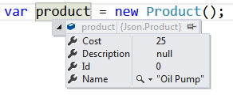
Serializing JSON
DataContractJsonSerializer can serialize an object:
static string SerializeJson<T>(T obj)
{
var serializer = new DataContractJsonSerializer(obj.GetType());
using (var stream = new MemoryStream())
{
serializer.WriteObject(stream, obj);
var result = Encoding.UTF8.GetString(stream.ToArray());
return result;
}
}
{
"Id":0,
"Name":"Oil Pump",
"Description":null,
"Cost":25
}

Slide 239
Deserializing JSON
DataContractJsonSerializer can deserialize a JSON string:
static T DeserializeJson<T>(string jsonString)
{
var serializer = new DataContractJsonSerializer(typeof(T));
var jsonStringBytes = Encoding.UTF8.GetBytes(jsonString);
using (var stream = new MemoryStream(jsonStringBytes))
{
var result = (T)serializer.ReadObject(stream);
return result;
}
}
{
"Id":0,
"Name":"Oil Pump",
"Description":null,
"Cost":25
}

Slide 240
Newtonsoft
Json.NET
JSON.NET
Better JSON Parsing for .NET Developers

Slide 241
What is JSON.NET?
JSON.NET is a JSON framework for .NET
More functionality than built-in functionality
Supports LINQ-to-JSON
Out-of-the-box support for parsing between JSON and XML
Open-source project: http://www.newtonsoft.com
Json.NET vs .NET Serializers: https://www.newtonsoft.com/json/help/html/JsonNetVsDotNetSerializers.htm

Slide 242
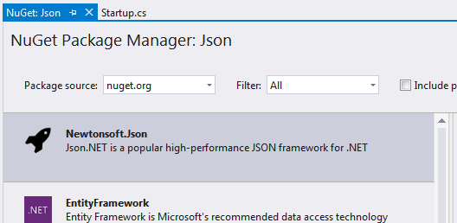
Installing JSON.NET
To install JSON.NET use the NuGet Package Manager:
Or with a command in the Package Manager Console:
Install-Package Newtonsoft.Json

Slide 243
General Usage
JSON.NET exposes a static service JsonConvert
Used for parsing and configuration
To Serialize an object:
To Deserialize an object:
var jsonProduct = JsonConvert.SerializeObject(product);
var objProduct =
JsonConvert.DeserializeObject<Product>(jsonProduct);

Slide 244
JSON.NET Features
JSON.NET can be configured to:
Indent the output JSON string
To convert JSON to anonymous types
To control the casing and properties to parse
To skip errors
JSON.NET also supports:
LINQ-to-JSON
Direct parsing between XML and JSON

Slide 245
Configuring JSON.NET
By default, the result is a single line of text
To indent the output string use Formatting.Indented
JsonConvert.SerializeObject(products, Formatting.Indented);
{
"pump": {
"Id": 0,
"Name": "Oil Pump",
"Description": null,
"Cost": 25.0
},
"filter": {
"Id": 0,
"Name": "Oil Filter",
"Description": null,
"Cost": 15.0
}
}

Slide 246
Configuring JSON.NET
Deserializing to anonymous types:
Incoming JSON
var json = @"{ 'firstName': 'Vladimir',
'lastName': 'Georgiev', 'jobTitle': 'Technical Trainer' }";
var template = new
{
FirstName = string.Empty,
LastName = string.Empty,
Occupation = string.Empty
};
var person = JsonConvert.DeserializeAnonymousType(json, template);
Template objects

Slide 247
JSON.NET Parsing of Objects
By default JSON.NET takes each property / field from the class and parses it
This can be controlled using attributes:
public class User
{
[JsonProperty("user")]
public string Username { get; set; }
[JsonIgnore]
public string Password { get; set; }
}
Parse Username to user
Skip the property

Slide 248
JSON.NET Parsing of Objects
By default JSON.NET takes each property / field from the class and parses it
This can be controlled using ContractResolver:
DefaultContractResolver contractResolver = new DefaultContractResolver()
{
NamingStrategy = new SnakeCaseNamingStrategy()
};
var serialized = JsonConvert.SerializeObject(person, new JsonSerializerSettings()
{
ContractResolver = contractResolver,
Formatting = Formatting.Indented
});

Slide 249
LINQ-to-JSON
LINQ-to-JSON works with JObjects
Create from JSON string:
Reading from file:
Using JObject:
JObject obj = JObject.Parse(jsonProduct);
var people = JObject.Parse(File.ReadAllText(@"c:\people.json"))
foreach (JToken person in people)
{
Console.WriteLine(person["FirstName"]); // Ivan
Console.WriteLine(person["LastName"]); // Petrov
}

Slide 250
LINQ-to-JSON (2)
JObjects can be queried with LINQ
var json = JObject.Parse(@"{'products': [
{'name': 'Fruits', 'products': ['apple', 'banana']},
{'name': 'Vegetables', 'products': ['cucumber']}]}");
var products = json["products"].Select(t =>
string.Format("{0} ({1})",
t["name"],
string.Join(", ", c["products"])
))
// Fruits (apple, banana)
// Vegetables (cucumber)

Slide 251
XML-to-JSON
{
"?xml": {
"@version": "1.0",
"@standalone": "no"
},
"root": {
"person": [
{
"@id": "1",
"name": "Alan",
"url": "www.google.com"
},
{
"@id": "2",
"name": "Louis",
"url": "www.yahoo.com"
}
]
}
}
string xml = @"<?xml version='1.0' standalone='no'?>
<root>
<person id='1'>
<name>Alan</name>
<url>www.google.com</url>
</person>
<person id='2'>
<name>Louis</name>
<url>www.yahoo.com</url>
</person>
</root>";
XmlDocument doc = new XmlDocument();
doc.LoadXml(xml);
string jsonText = JsonConvert.SerializeXmlNode(doc);

Slide 252
Summary
…
…
…
JSON is cross platform data format
DataContractJsonSerializer is the default JSON Parser in C#
JSON.NET is a fast framework for working with JSON data

Slide 253
https://softuni.bg/courses/databases-advanced-entity-framework

Slide 254
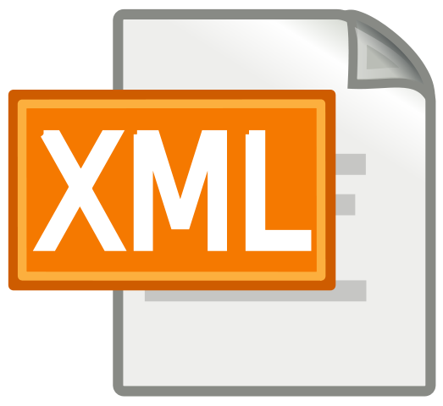
XML Processing
Parsing XML
XDocument and LINQ
SoftUni Team
Technical Trainers
Technical Trainers
Software University

Slide 255
Table of Contents
XML Format
Processing XML
XML in Entity Framework
XML Attributes

Slide 256
Have a Question?
sli.do
#csharp-db

Slide 257

What is XML?
Format Description and Application

Slide 258
What is XML?
EXtensible Markup Language
Universal notation (data format / language) for describing structured data using text with tags
Designed to store and transport data
The data is stored together with the meta-data about it

Slide 259
XML – Example
XML header tag (prolog)
Attribute (key / value pair)
<?xml version="1.0"?>
<library name="Developer's Library">
<book>
<title>Professional C# 4.0 and .NET 4</title>
<author>Christian Nagel</author>
<isbn>978-0-470-50225-9</isbn>
</book>
<book>
<title>Teach Yourself XML in 10 Minutes</title>
<author>Andrew H. Watt</author>
<isbn>978-0-672-32471-0</isbn>
</book>
</library>
Root (document) element
Element
Opening tag
Element value
Closing tag

Slide 260
XML Syntax
Header – defines a version and character encoding
Elements – define the structure
Attributes – element metadata
Values – actual data, that can also be nested elements
Root element – required to only have one
<?xml version="1.0" encoding="UTF-8"?>
Element name
Attribute
Value
<title lang="en">Professional C# 4.0 and .NET 4</title>

Slide 261
XML - Structure
Document
Header
Document root
Attribute
Xml
version: 1.0
Library
name: Developer's Library
Book
Book
Book
Book
Child elements
Title
Author
ISBN
Professional C# 4.0 and .NET 4
Christian Nagel
978-0-470-50225-9
Value

Slide 262

XML and HTML
Similarities between XML and HTML
Both are text based notations
Both use tags and attributes
Differences between XML and HTML
HTML describes documents, XML is a syntax for describing other languages (meta-language)
HTML describes the layout and the structure of information
XML requires the documents to be well-formatted

Slide 263

XML: Advantages
Advantages of XML:
XML is human-readable (unlike binary formats)
Stores any kind of structured data
Data comes with self-describing meta-data
Full Unicode support
Custom XML-based languages can be designed for certain apps
Parsers available for virtually all languages and platforms

Slide 264
XML: Disadvantages
Disadvantages of XML:
XML data is bigger (takes more space) than binary or JSON
More memory consumption, more network traffic, more hard-disk space, more resources, etc.
Decreased performance
CPU consumption: need of parsing / constructing the XML tags
XML is not suitable for all kinds of data
E.g. binary data: graphics, images, videos, etc.

Slide 265


Parsing XML
Using XDocument and LINQ

Slide 266
LINQ to XML
LINQ to XML
Use the power of LINQ to process XML data
Easily read, search, write, modify XML documents
LINQ to XML classes:
XDocument – represents a LINQ-enabled XML document (containing prolog, root element, …)
XElement – main component holding information

Slide 267
Reading XML
To process an XML string:
Loading XML directly from file:
string str =
@"<?xml version=""1.0""?>
<!-- comment at the root level -->
<Root>
<Child>Content</Child>
</Root>";
XDocument doc = XDocument.Parse(str);
XDocument xmlDoc = XDocument.Load("../../books.xml");

Slide 268
Working with XDocument
Get collection of children
Access root element
Access element by name
var cars = xmlDoc.Root.Elements();
foreach (var car in cars)
{
string make = car.Element("make").Value;
string model = car.Element("model").Value;
Console.WriteLine($"{make} {model}");
}
Get value

Slide 269
Working with XDocument (2)
Set an element value by name
If it doesn't exist, it will be added
If it is set to null, it will be removed
Remove an element from its parent
customer.SetElementValue("birth-date", "1990-10-04T00:00:00");
var youngDriver = customer.Element("is-young-driver");
youngDriver.Remove();

Slide 270
Working with XDocument (3)
Get or set an element attribute by name
Get a list of all attributes for an element
Set an attribute value by name
If it doesn't exist, it will be added
If it is set to null, it will be removed
customer.Attribute("name").Value
var attrs = customer.Attributes;
customer.SetAttributeValue("age", "21");

Slide 271
LINQ to XML – Searching with LINQ
Searching in XML with LINQ is like searching with LINQ in array
XDocument xmlDoc = XDocument.Load("cars.xml");
var cars = xmlDoc.Root.Elements()
.Where(e => e.Element("make").Value == "Opel" &&
(long)e.Element("travelled-distance") >= 300000)
.Select(c => new
{
Model = c.Element("model").Value,
Traveled = c.Element("travelled-distance").Value
})
.ToList();
foreach (var car in cars)
Console.WriteLine(car.Model + " " + car.Traveled);

Slide 272
Creating XML with XElement
XDocuments can be composed from XElements and XAttributes
<books>
<book>
<author>Don Box</author>
<title lang="en">Essential .NET</title>
</book>
</book>
XDocument xmlDoc = new XDocument();
xmlDoc.Add(
new XElement("books",
new XElement("book",
new XElement("author", "Don Box"),
new XElement("title", "ASP.NET", new XAttribute("lang", "en"))
)));
Added with value
Add as root
Optional attribute

Slide 273
Serializing XML to File
To flush a XDocument to file with default settings:
To disable automatic indentation:
To serialize any object to file:
xmlDoc.Save("myBooks.xml");
xmlDoc.Save("myBooks.xml", SaveOptions.DisableFormatting);
var serializer = new XmlSerializer(typeof(ProductDTO));
using (var writer = new StreamWriter("myProduct.xml");)
{
serializer.Serialize(writer, product);
}

Slide 274
Deserialize XML from String XML
To deserialize an object from a XML string
Specifying root attribute name
var serializer = new XmlSerializer(typeof(OrderDto[]), new XmlRootAttribute("Orders"));
var deserializedOrders =
(OrderDto[])serializer.Deserialize(new StringReader(xmlString));
var attr = new XmlRootAttribute("Orders");
var serializer = new XmlSerializer(typeof(OrderDto[]), attr);
var deserializedOrders =
(OrderDto[])serializer.Deserialize(new StringReader(xmlString));

Slide 275

XML Attributes
Using xml attributes

Slide 276
XML Attributes
We can use several attributes to control serialization to XML
[XmlType("Name")] – Specifies the type’s name in XML
[XmlAttribute("name")] – Serializes as XML Attribute
[XmlElement] – Serialize as XML Element
[XmlIgnore] – Do not serialize
[XmlArray] – Serialize as an array of XML elements
[XmlRoot] – Specifies the root element name
[XmlText] – Serialize multiple xml elements on one line

Slide 277
XML Attributes: Example
We can use several XML attributes to control serialization
XML Type name
[XmlType("Book")]
public class BookDto
{
[XmlAttribute("name")]
public string Name { get; }
[XmlElement("Author")]
public string Author { get; }
[XmlIgnore]
public decimal Price { get; }
}
<Book name="It">
<Author>Stephen King</Author>
</Book>
<Book name="Frankenstein">
<Author>Mary Shelley</Author>
</Book>
<Book name="Queen Lucia">
<Author>E.F. Benson</Author>
</Book>
<Book name="Paper Towns">
<Author>John Green</Author>
</Book>
Not serialized

Slide 278

XML Serialization
Live Demo

Slide 279
Summary
XDocument is a system object for working with XML in .NET, which supports LINQ
XML can be read and saved directly to file
XML Attributes are easy way to describe the XML file
…
…
…

Slide 280

Design Patterns
SoftUni Team
Technical Trainers
Software University
http://softuni.bg

Slide 281
Table of Contents
Definition of Design Patterns
Benefits and Drawbacks
Types of Design Patterns
Creational
Structural
Behavioral

Slide 282
Have a Question?
sli.do
#csharp-advanced

Slide 283

Design Patterns
Definition, Solutions and Elements

Slide 284
What are Design Patterns?
General and reusable solutions to common problems in software design
A template for solving given problems
Add additional layers of abstraction in order to reach flexibility

Slide 285
What do Design Patterns Solve?
Patterns solve software structural problems like:
Abstraction
Encapsulation
Separation of concerns
Coupling and cohesion
Separation of interface and implementation
Divide and conquer

Slide 286
Elements of a Design Pattern
Pattern name - Increases vocabulary of designers
Problem - Intent, context and when to apply
Solution - Abstract code
Consequences - Results and trade-offs

Slide 287

Why Design Patterns?
Benefits and Drawbacks

Slide 288

Benefits
Names form a common vocabulary
Enable large-scale reuse of software architectures
Help improve developer communication
Help ease the transition to Object Oriented technology
Can speed-up the development

Slide 289

Drawbacks
Do not lead to a direct code reuse
Deceptively simple
Developers may suffer from pattern overload and overdesign
Validated by experience and discussion, not by automated testing
Should be used only of understood well

Slide 290



Types of Design Patterns

Slide 291
Main Types
Creational patterns
Deal with initialization and configuration of classes and objects
Structural patterns
Describe ways to assemble objects to implement new functionality
Composition of classes and objects
Behavioral patterns
Deal with dynamic interactions among societies of classes
Distribute responsibility

Slide 292

Creational Patterns

Slide 293
Purposes
Deal with object creation mechanisms
Trying to create objects in a manner suitable to the situation
Two main ideas
Encapsulating knowledge about which classes the system uses
Hiding how instances of these classes are created

Slide 294
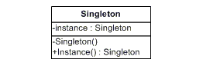
Singleton Pattern
The most often used creational design pattern
A Singleton class is supposed to have only one instance
It is not a global variable
Possible problems
Lazy loading
Thread-safe

Slide 295
Double-Check Singleton Example
public sealed class Singleton {
private static Singleton instance;
private Singleton() { }
public static Singleton Instance {
get {
if (instance == null) {
lock (instance) {
if (instance == null)
instance = new Singleton(); } }
return instance; } } }

Slide 296
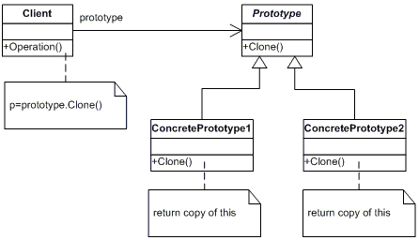
Prototype Pattern
Factory for cloning new instances from a prototype
Create new objects by copying this prototype
Instead if using the "new" keyword
ICloneable interface acts as Prototype

Slide 297
The Prototype Abstract Class
abstract class Prototype {
private string _id;
public Prototype(string id) {
this._id = id; }
public string Id => this._id;
public abstract Prototype Clone();
}

Slide 298
A Concrete Prototype Class
class ConcretePrototype : Prototype
{
public ConcretePrototype(string id) : base(id) { }
public override Prototype Clone()
=> return (Prototype)this.MemberwiseClone();
}

Slide 299

Structural Patterns

Slide 300
Purposes
Describe ways to assemble objects to implement a new functionality
Ease the design by identifying a simple way to realize relationship between entities
All about Class and Object composition
Inheritance to compose interfaces
Ways to compose objects to obtain new functionality

Slide 301
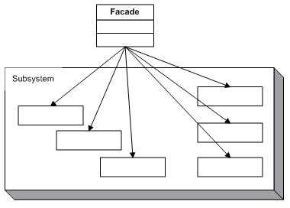
Façade Pattern
Provides a unified interface to a set of interfaces in a subsystem
Defines a higher-level interface that makes the subsystem easier to use

Slide 302
The Façade Class (1)
class Facade
{
private SubSystemOne _one;
private SubSystemTwo _two;
public Facade()
{
_one = new SubSystemOne();
_two = new SubSystemTwo();
}

Slide 303
The Façade Class (2)
public void MethodA() {
Console.WriteLine("\nMethodA() ---- ");
_one.MethodOne();
_two.MethodTwo(); }
public void MethodB() {
Console.WriteLine("\nMethodB() ---- ");
_two.MethodTwo(); }
}

Slide 304
Subsystem Classes
class SubSystemOne
{
public void MethodOne()
=> Console.WriteLine(" SubSystemOne Method");
}
class SubSystemTwo
{
public void MethodTwo()
=> Console.WriteLine(" SubSystemTwo Method");
}

Slide 305
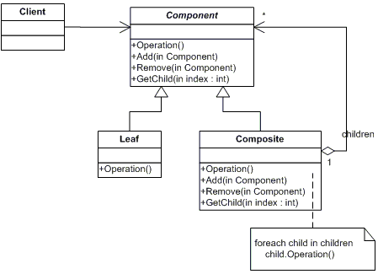
Composite Pattern
Allows to combine different types of objects in tree structures
Gives the possibility to treat the same object(s)
Used when
You have different objects that you want to treat the same way
You want to present hierarchy of objects

Slide 306
The Component Abstract Class
abstract class Component {
protected string name;
public Component(string name) {
this.name = name; }
public abstract void Add(Component c);
public abstract void Remove(Component c);
public abstract void Display(int depth);
}

Slide 307
The Composite Class (1)
class Composite : Component {
private List<Component> _children = new List<Component>();
public Composite(string name) : base(name) { }
public override void Add(Component component)
=> _children.Add(component);
public override void Remove(Component component)
=> _children.Remove(component);

Slide 308
The Composite Class (2)
public override void Display(int depth)
{
Console.WriteLine(new String('-', depth) + name);
foreach (Component component in _children)
{
component.Display(depth + 2);
}
}
}

Slide 309
The Leaf Class
class Leaf : Component {
public Leaf(string name) : base(name) { }
public override void Add(Component c)
=> Console.WriteLine("Cannot add to a leaf");
public override void Remove(Component c)
=> Console.WriteLine("Cannot remove from a leaf");
public override void Display(int depth)
=> Console.WriteLine(new String('-', depth) + name);
}

Slide 310

Behavioral Patterns

Slide 311
Purposes
Concerned with interaction between objects
Either with the assignment of responsibilities between objects
Or encapsulating behavior in an object and delegating requests to it
Increases flexibility in carrying out cross-classes communication

Slide 312
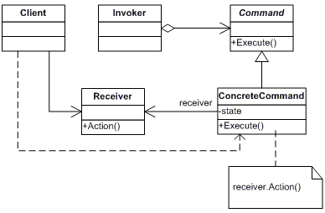
Command Pattern
An object encapsulates all the information needed to call a method at a later time
Lets you parameterize clients with different requests, queue or log requests, and support undoable operations

Slide 313
The Command Abstract Class
abstract class Command
{
protected Receiver receiver;
public Command(Receiver receiver) {
this.receiver = receiver; }
public abstract void Execute();
}

Slide 314
Concrete Command Class
class ConcreteCommand : Command
{
public ConcreteCommand(Receiver receiver)
: base(receiver) { }
public override void Execute()
=> receiver.Action();
}

Slide 315
The Receiver Class
class Receiver
{
public void Action()
{
Console.WriteLine("Called Receiver.Action()");
}
}

Slide 316
The Invoker Class
class Invoker
{
private Command _command;
public void SetCommand(Command command)
=> this._command = command;
public void ExecuteCommand()
=> _command.Execute();
}

Slide 317
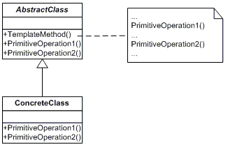
Template Pattern
Define the skeleton of an algorithm in a method, leaving some implementation to its subclasses
Allows the subclasses to redefine the implementation of some of the parts of the algorithm, but not its structure

Slide 318
The Abstract Class
abstract class AbstractClass
{
public abstract void PrimitiveOperation1();
public abstract void PrimitiveOperation2();
public void TemplateMethod() {
PrimitiveOperation1();
PrimitiveOperation2();
Console.WriteLine(""); }
}

Slide 319
A Concrete Class
class ConcreteClassA : AbstractClass
{
public override void PrimitiveOperation1()
=> Console.WriteLine("ConcreteClassA. PrimitiveOperation1()");
public override void PrimitiveOperation2()
=> Console.WriteLine("ConcreteClassA .PrimitiveOperation2()");
}

Slide 320
Summary
…
…
…
Design Patterns
Provide solution to common problems
Add additional layers of abstraction
Three main types of Design Patterns
Creational
Structural
Behavioral

Slide 321
https://softuni.bg/courses/csharp-advanced

